Slide 1
ADFS 4.0 – Server 2016
OAuth 2.0 – Device Profile
Rory Braybrook
Identity Architect (Microsoft stack)
@rbrayb

Slide 2
ADFS 4.0

Slide 3
ADFS 4.0 – Server 2016
Open ID Connect / OAuth 2.0 support
Azure MFA without the need for an on-premises Azure MFA server.
Improved device registration for delivering hybrid conditional access
Windows 10 and Microsoft Passport integration
Greater integration with LDAP directories to secure non-AD directories (ADAM – AD LDS)

Slide 4
ADFS 4.0 – Server 2016
Improved interoperability with SAML 2.0
Customize sign in experience for AD FS applications (RP)
Configure access control policies without having to know claim rules language
Moving from AD FS in Windows Server 2012 R2 to AD FS in Windows Server 2016 is easier

Slide 5
Demo
ADFS 4.0

Slide 6
ADFS 4.0 OIDC – OAuth 2.0

Slide 7
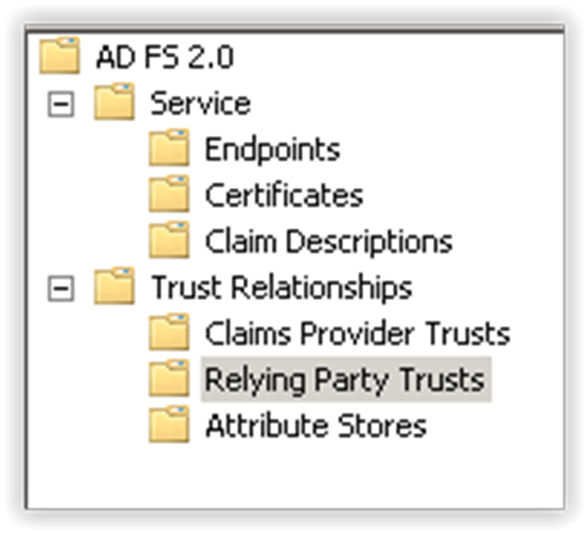
ADFS 2.0

Slide 8
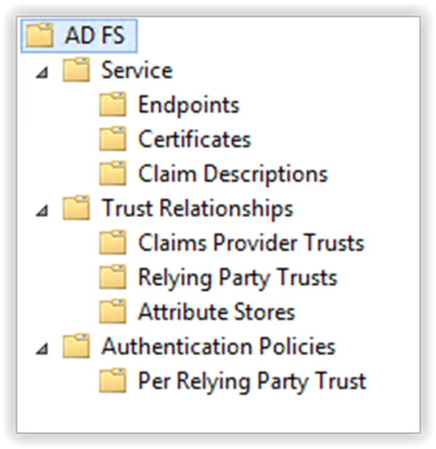
ADFS 3.0

Slide 9
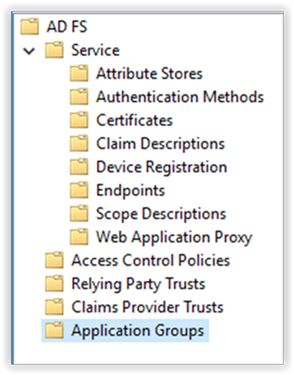
ADFS 4.0

Slide 10
Flows and endpoints
Authorisation code grant
Client credentials grant

Slide 11
Endpoints
https://adfsvnexttp5.cloudapp.net/adfs/.well-known/openid-configuration
https://adfsvnexttp5.cloudapp.net/adfs/discovery/keys
https://adfsvnexttp5.cloudapp.net/adfs/userinfo
https://adfsvnexttp5.cloudapp.net/adfs/oauth2/authorize
https://adfsvnexttp5.cloudapp.net/adfs/oauth2/token

Slide 12
GET Authorize endpoint
Authorisation code grant
https://adfsvnexttp5.cloudapp.net/adfs/oauth2/authorize
?client_id=37f…b0e
&response_type=code
&redirect_uri=https%3A%2F%2Flocalhost%3A1234
&response_mode=query
&scope=openid

Slide 13
POST Token endpoint
https://adfsvnexttp5.cloudapp.net/adfs/oauth2/token
?client_id=37fd…0b0e
&scope=openid
&redirect_uri=https%3A%2F%2Flocalhost%3A1234
&grant_type=authorization_code
&client_secret=Rel1…GSG9
&code=NjX0…83Wew

Slide 14
POST Token endpoint
Client credential grant
https://adfsvnexttp5.cloudapp.net/adfs/oauth2/token
?client_id=37fd…0b0e
&scope=openid
&grant_type=client_credentials
&client_secret=Rel1…GSG9

Slide 15
Demo
ADFS 4.0 – OIDC / OAuth with Postman

Slide 16
OAuth 2.0 Device Profile

Slide 17
OAuth 2.0 Device Profile
The device profile is suitable for clients executing on devices which do not have an easy data-entry method (e.g. game consoles or media hubs), but where the end-user has separate access to a user-agent on another computer or device (e.g. home computer, a laptop, or a smart phone). The client is incapable of receiving incoming requests from the authorization server (incapable of acting as an HTTP server).
The device profile is suitable for clients executing on devices which
do not have an easy data-entry method (e.g. game consoles or media
hubs), but where the end-user has separate access to a user-agent
on another computer or device (e.g. home computer, a laptop,
or a smart phone).
The client is incapable of receiving incoming requests from the
authorization server (incapable of acting as an HTTP server).

Slide 18
OAuth 2.0 Device Profile
The device profile is suitable for clients executing on devices which do not have an easy data-entry method (e.g. game consoles or media hubs), but where the end-user has separate access to a user-agent on another computer or device (e.g. home computer, a laptop, or a smart phone). The client is incapable of receiving incoming requests from the authorization server (incapable of acting as an HTTP server).
Instead of interacting with the end-user's user-agent, the client instructs the end-user to use another computer or device and connect to the authorization server to approve the access request.
Since the client cannot receive incoming requests, it polls the authorization server repeatedly until the end-user completes the approval process.

Slide 19
OAuth 2.0 Device Profile
The device profile is suitable for clients executing on devices which do not have an easy data-entry method (e.g. game consoles or media hubs), but where the end-user has separate access to a user-agent on another computer or device (e.g. home computer, a laptop, or a smart phone). The client is incapable of receiving incoming requests from the authorization server (incapable of acting as an HTTP server).
Use case:
Your application needs to invoke an API as an Azure AD user.
The token acquisition flow requires the user to do things that cannot be accomplished via text only output, such as granting consent or dealing with multiple authentication factors.

Slide 20
Demo
OAuth 2.0 – Device Profile on Azure AD

Slide 21
The end
But feel free to ask questions

