Slide 1
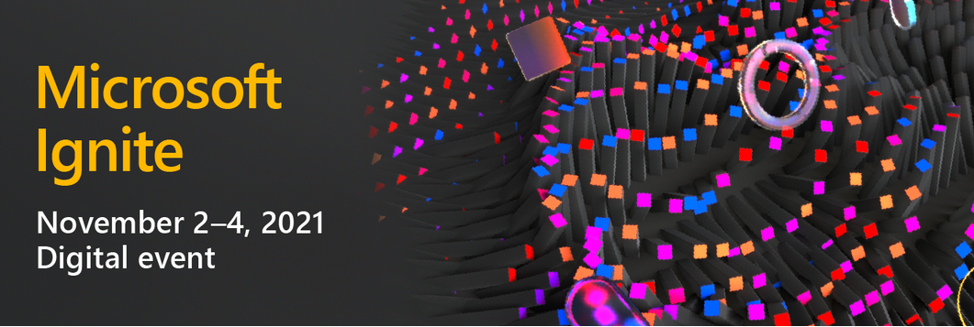

Slide 2
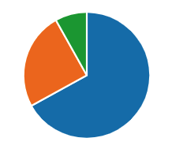
How much interest have we gathered?
206 After Parties
Where?
When?
January
9%
EMEA
40%
December
25%
APJGC
33%
NORTH AMERICA
14%
November
66%
LATAM
12%

Slide 3
Agenda
Housekeeping
Code of conduct – be nice / be respectful
Introductions
Roll the video (around 30 minutes)
Q & A

Slide 4
Housekeeping
Please mute yourself
Ask questions in the chat OR
Raise your hand – you will be asked to come off mute
This session will be recorded
We will take a picture in “Together Mode” to share with Microsoft

Slide 5
The team
Back of house – Rory / Marcus / Xiaodi and Dan
Auckland and Wellington .NET and Azure UG
The panel:
Sonia Cuff, Will Velida, Shahid Iqbal, Alessandro Moura, Wagner Silveira and Chimène Bonhomme, all of whom work for Microsoft or are MVP’s in the Azure space
James Burton - Our publicist
Xiaobin Lin - Student ambassadors

Slide 6
aka.ms/PostIgnite
Discover additional learning resources, technical content and upcoming events through January 2022, such as:
Custom Learn Collections
On-Demand Content from Ignite
Learn Live Series (through Dec. 16)
Ask the Expert Show (through Dec. 17)
Community-led Table Talks (week of Nov. 15)
Cloud Skills Challenge (open until Nov. 30)

Slide 7
Learning collections
https://docs.microsoft.com/en-us/events/post-ignite-nov-2021/ignite-learn-collections/

