Slide 1
The Microsoft Identity Platform
Rory Braybrook
Microsoft Identity Architect
Microsoft MVP
@rbrayb

Slide 2
In the beginning …

Slide 3
Defining the Problem Working with identity is too hard (1)
But it appears so easy – a login screen with two textboxes ☺ How hard can that be?
The iceberg scenario – users only see the 10 % “above the surface”
Applications must use different identity technologies in different situations:
Developers don’t understand security – take short cuts
Results in multiple identities

Slide 4
Defining the Problem Working with identity is too hard (2)
Many different ways to access the identity repository – the “I can do better syndrome”
Reinventing the wheel
Different applications use different naming standards for the same identity attribute
Makes security reviews very complex
Why not define one approach that applications can use in all of these cases?
Claims-based identity allows this

Slide 5
Tokens and Claims Representing identity on the wire
A token is a set of bytes that expresses information about an identity
This information consists of one or more claims
Each claim contains some information about the entity to which this token applies
Token
Example Claims
Claim 1
Claim 2
Name
Indicates who created this token and guards against changes
Group
Claim 3
. . .
Age
Claim n
Signature

Slide 6
The Journey
Windows Identity Foundation (WIF)
XML based – web.config – WS-Federation
Windows Identity Foundation (WIF-SAML)
Open Web Interface for .NET (OWIN) - OIDC

Slide 7
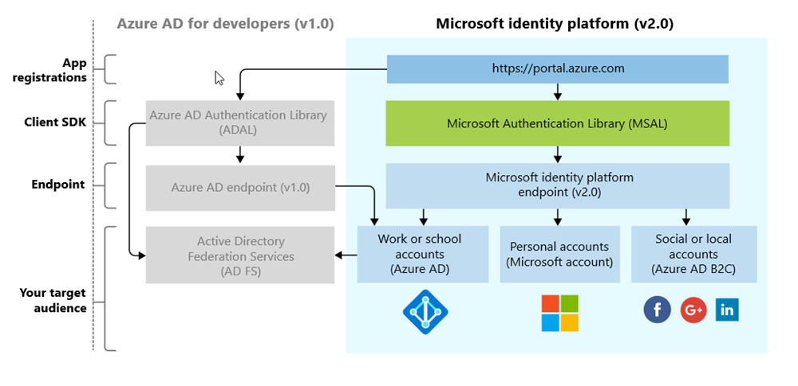
The Platform (not the Product!)

Slide 8
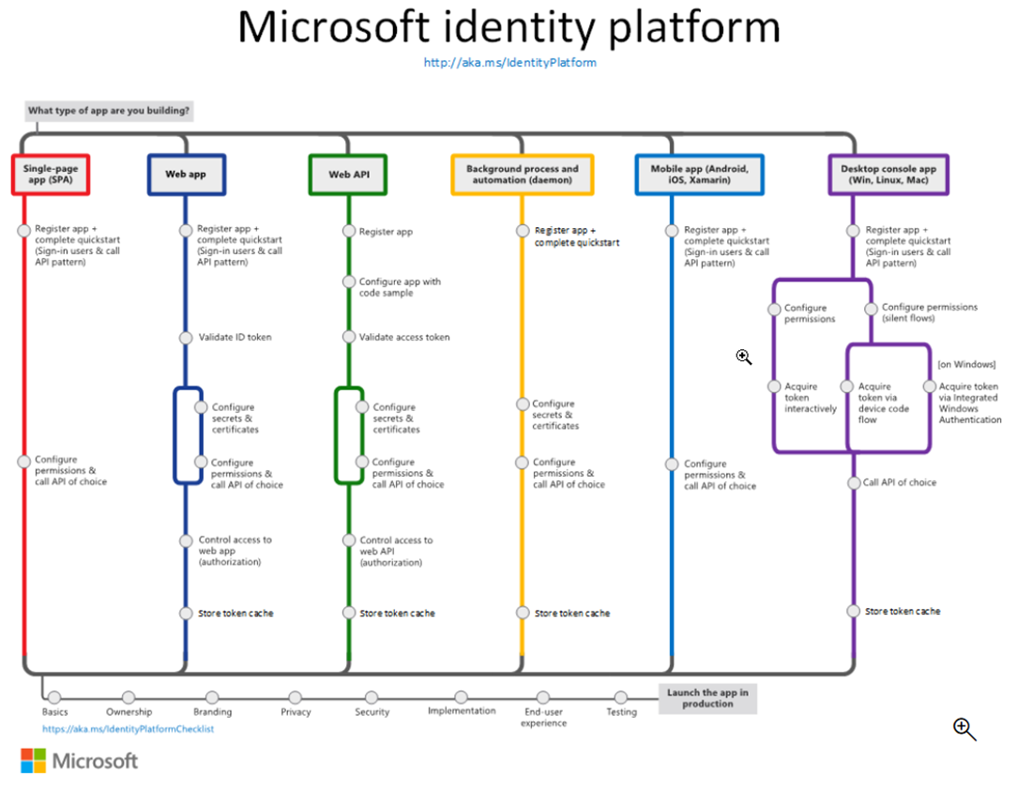

Slide 9
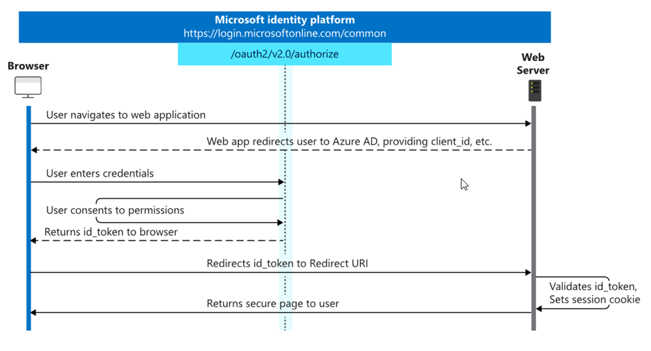
OpenID Connect

Slide 10
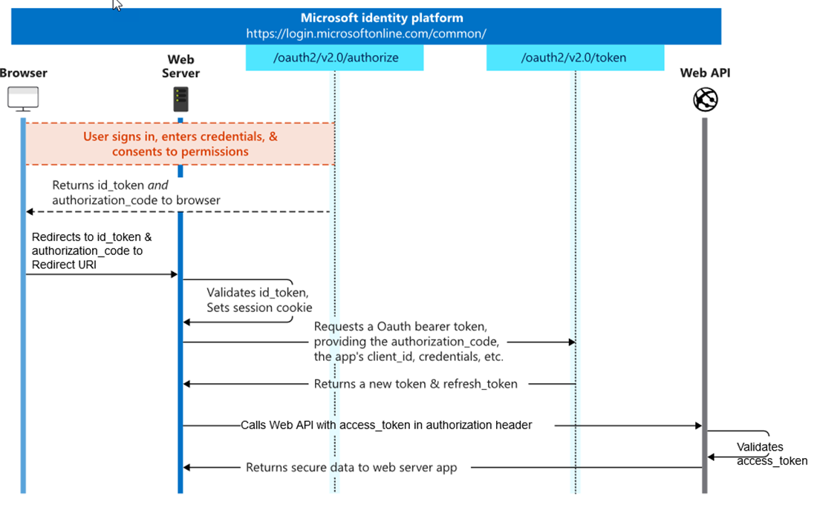
OAuth 2.0

Slide 11
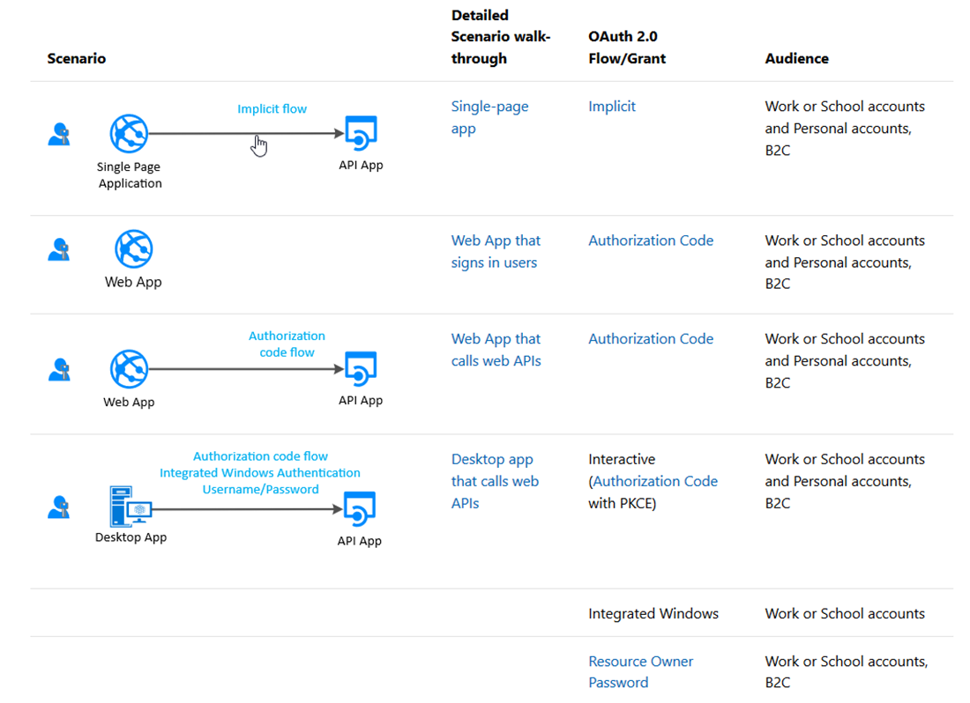
Scenarios

Slide 12
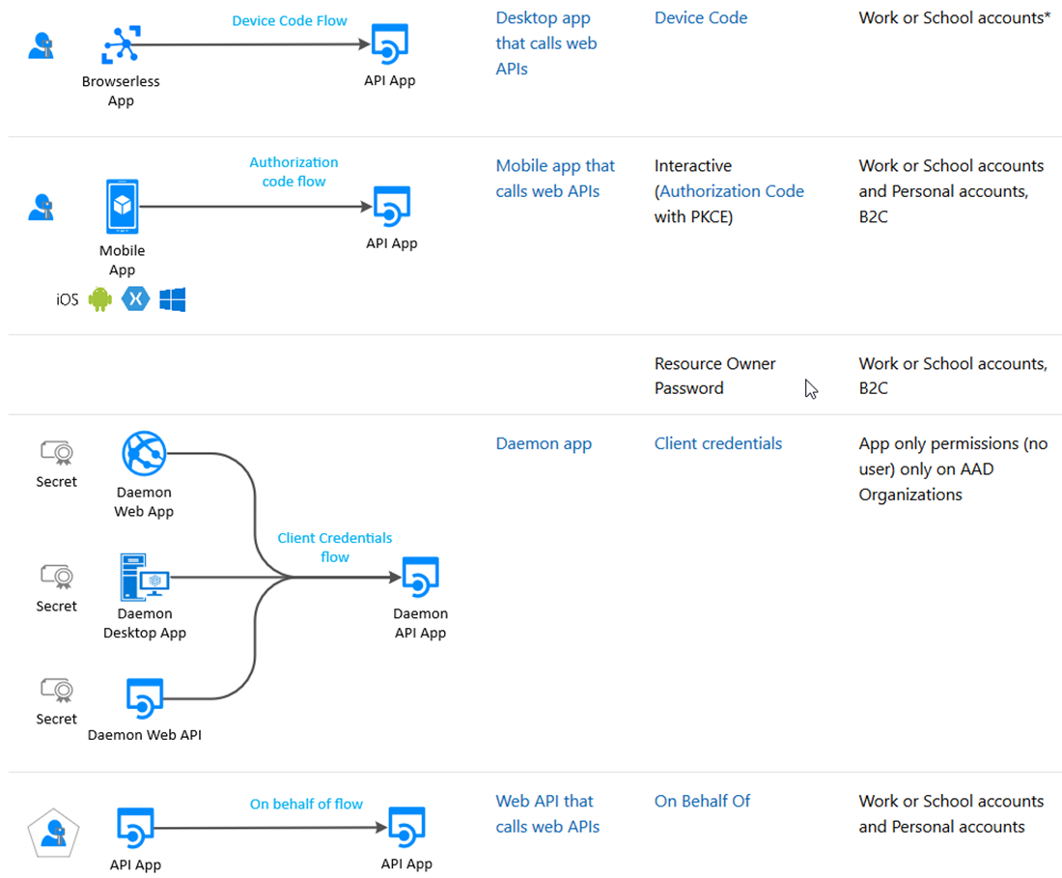
Scenarios

Slide 13
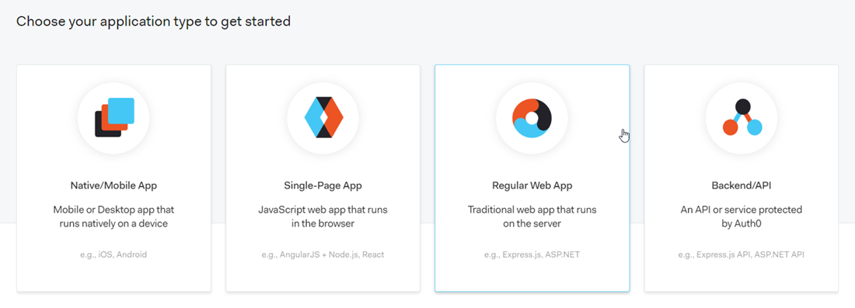
The Format – Auth0

Slide 14
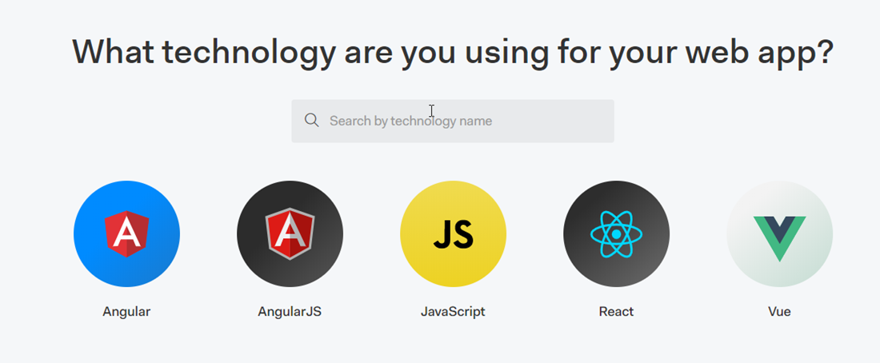
The Format – Auth0

Slide 15
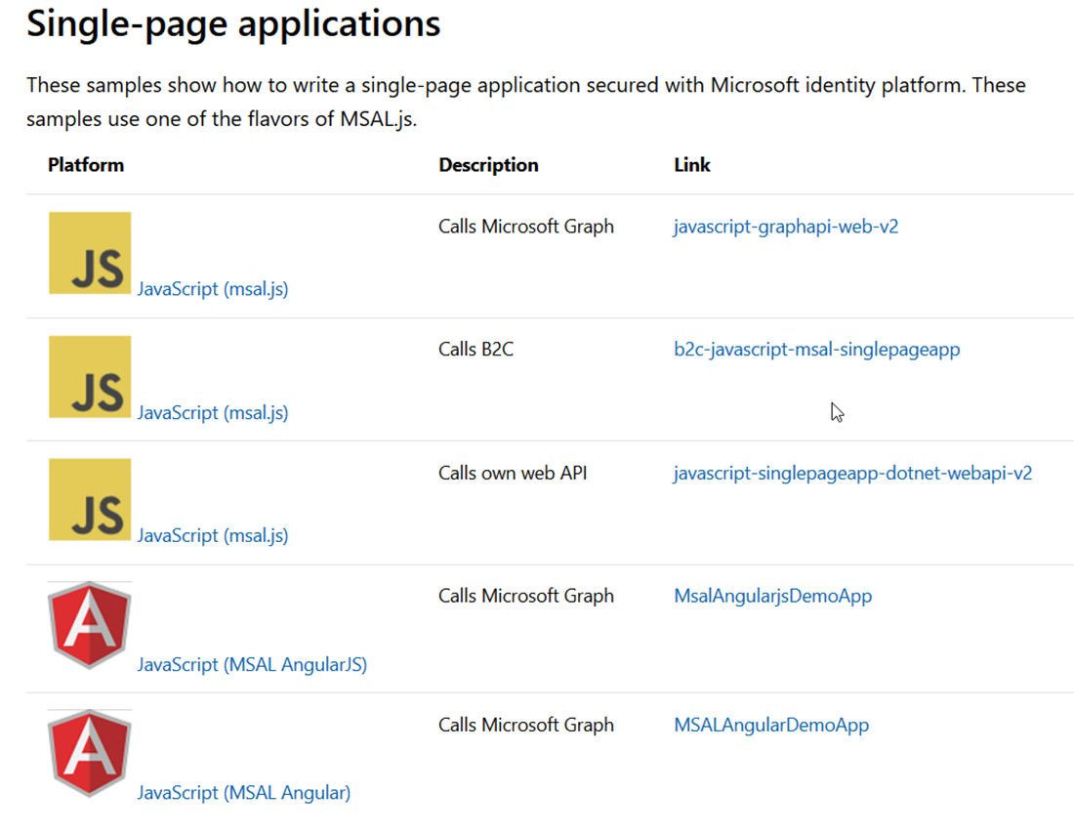
The Format – SPA

Slide 16
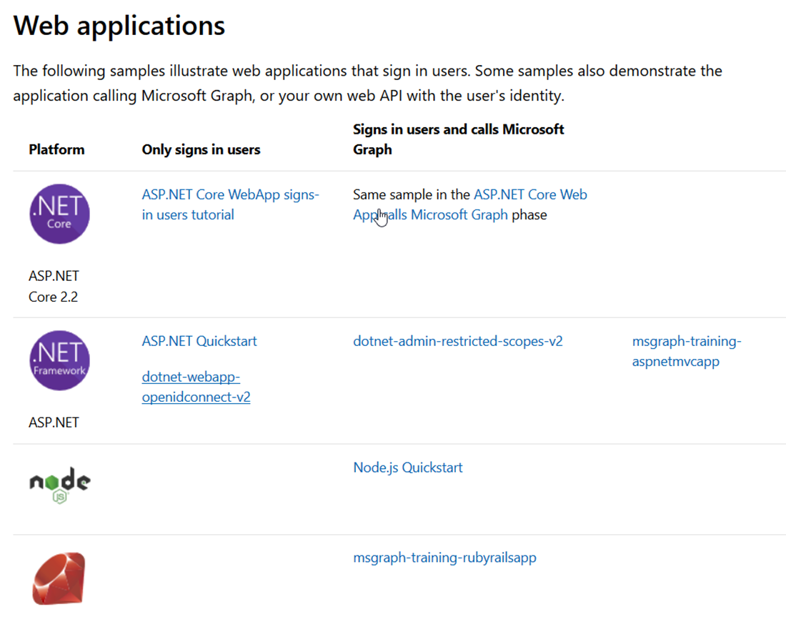
The Format – Web

Slide 17
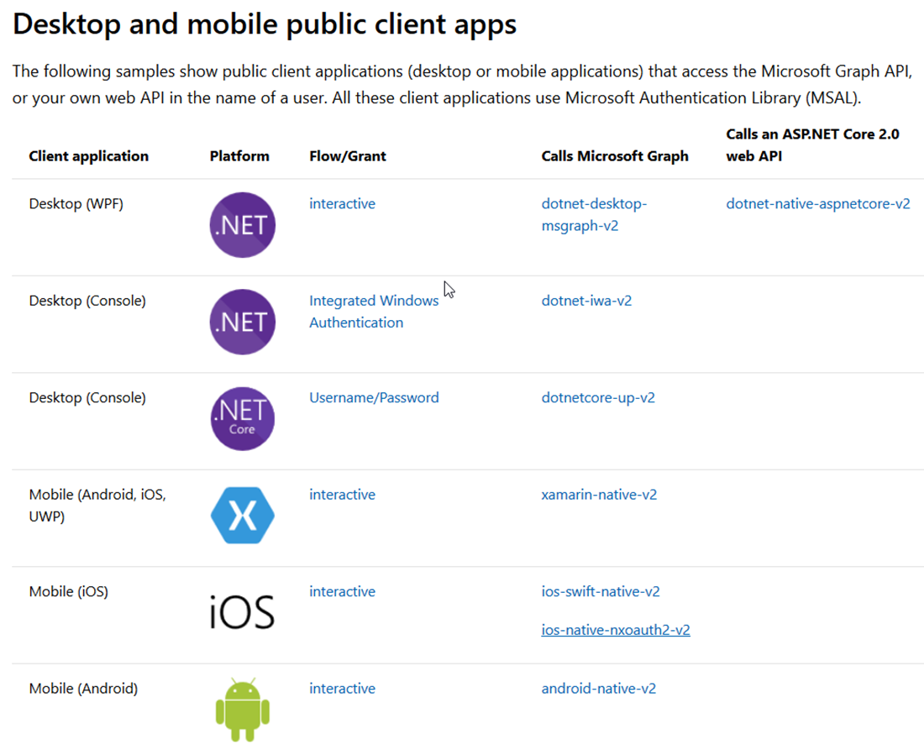
The Format – Native (User)

Slide 18
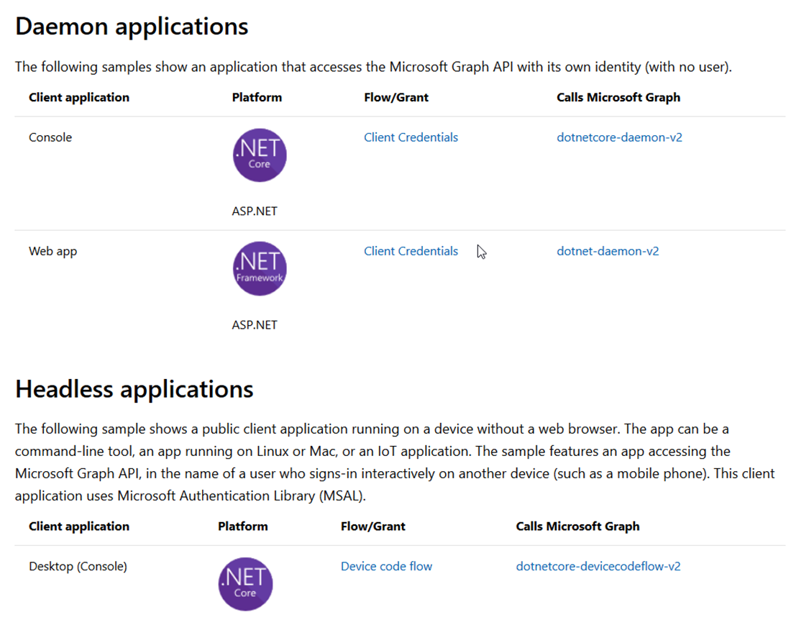
The Format – Native (Application)

Slide 19
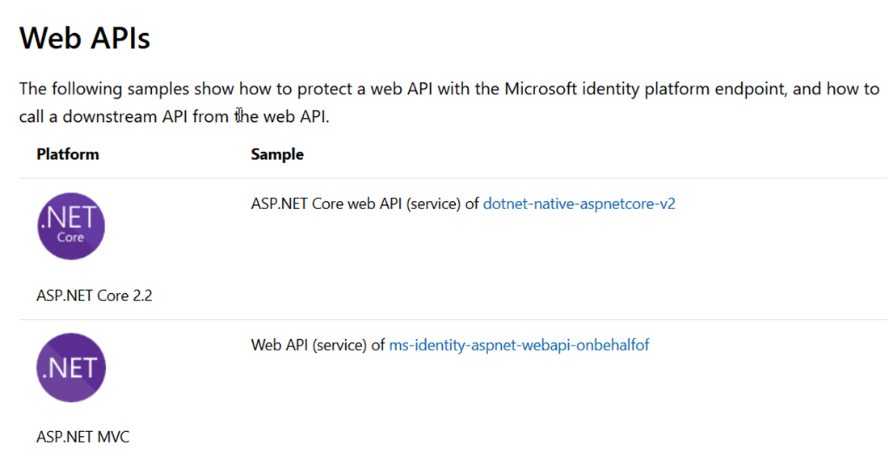
The Format – Web API

Slide 20
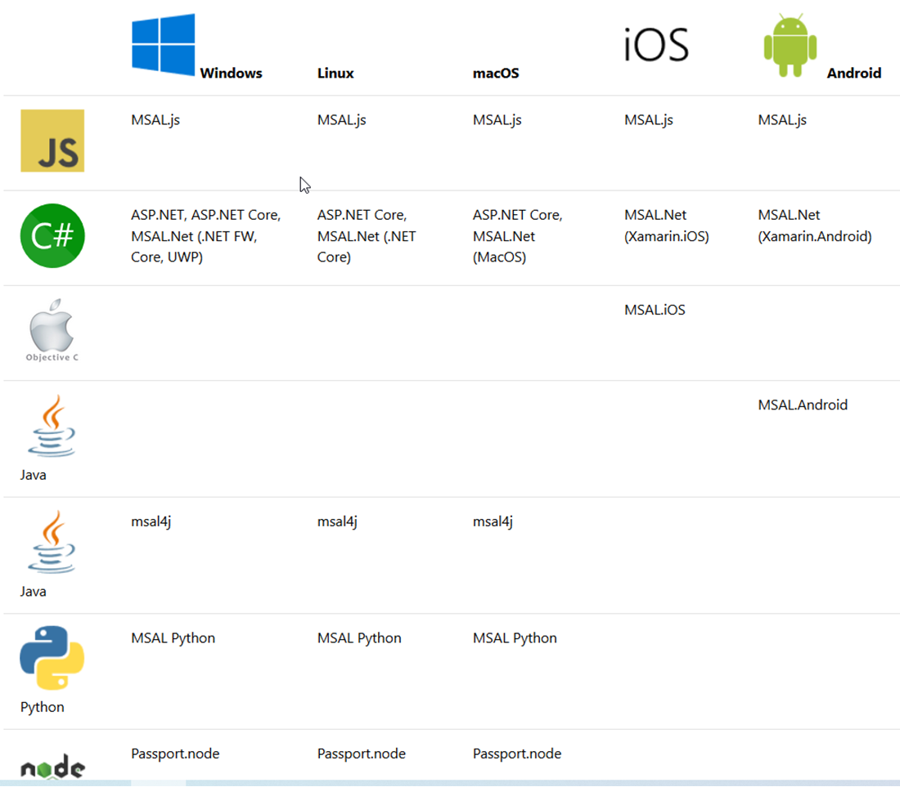
The OS

Slide 21
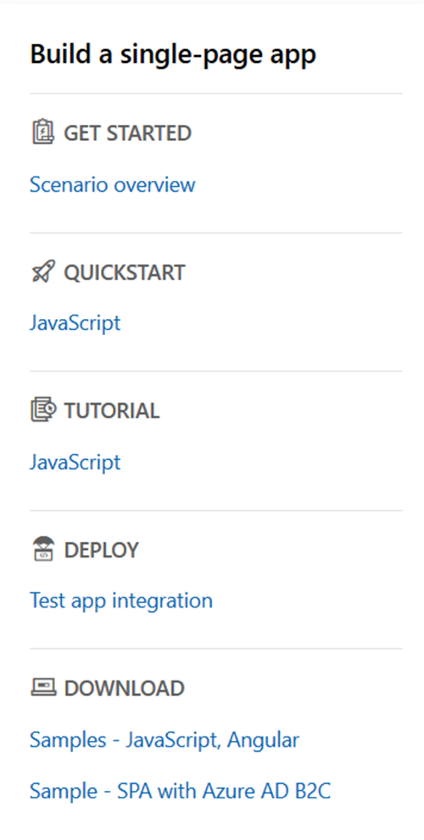
The Menu

Slide 22
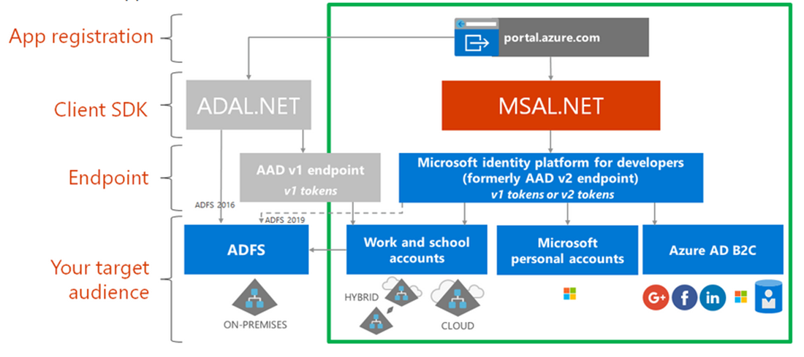
ADAL - MSAL

Slide 23
The Endpoints

Slide 24
Types of tenant
You can restrict the types available by modifying the authority URL.
https://login.microsoftonline.com/common/v2.0
The default, allows any account
https://login.microsoftonline.com/organizations/v2.0
Allow only Azure AD/Office 365 accounts
https://login.microsoftonline.com/consumers/v2.0
Allow only personal MS accounts
https://login.microsoftonline.com/{tenant-id}/v2.0
Allow only a specific Azure AD tenant

Slide 25
Resources / scopes
ADAL
Resource URI
https://graph.microsoft.com
MSAL
Scope
https://graph.microsoft.com/Calendars.Read
Scope=Calendars.Read

Slide 26
The rest
MSAL - ADFS
MSAL connects to Azure AD, which is federated with AD FS
MSAL connects directly to AD FS (Server 2019) (Azure Stack)
Can use ADAL (Samples available)
MSAL – Azure AD B2C
JS
.NET
Samples available

Slide 27
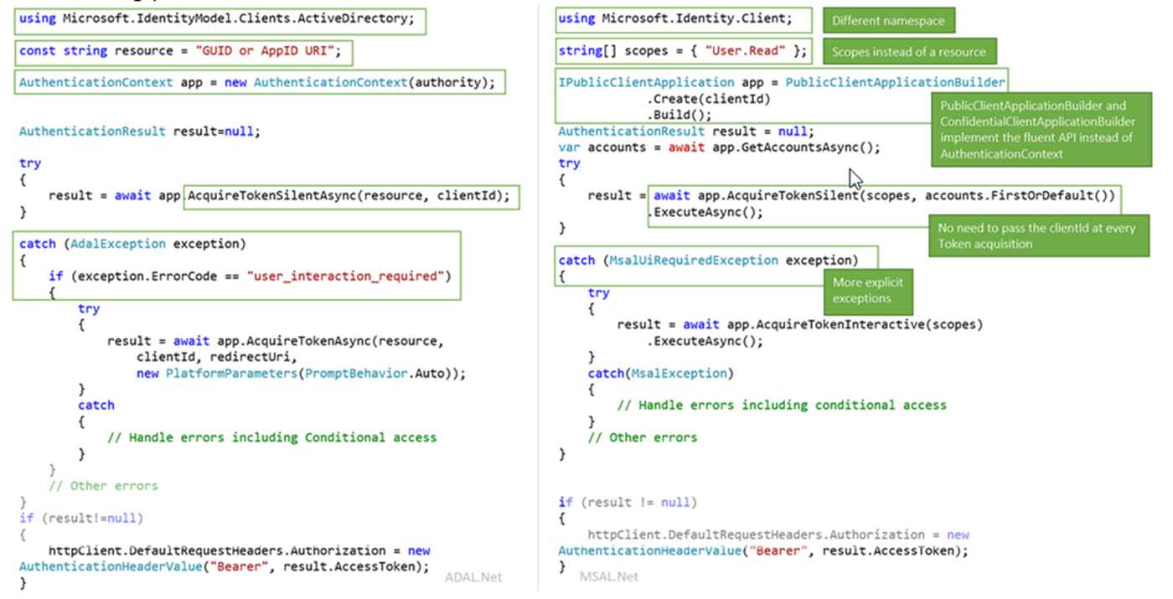
ADAL – MSAL - code

Slide 28
The Demo
The old way
Connected Services
.NET Core B2C
New application registration
Samples

Slide 29
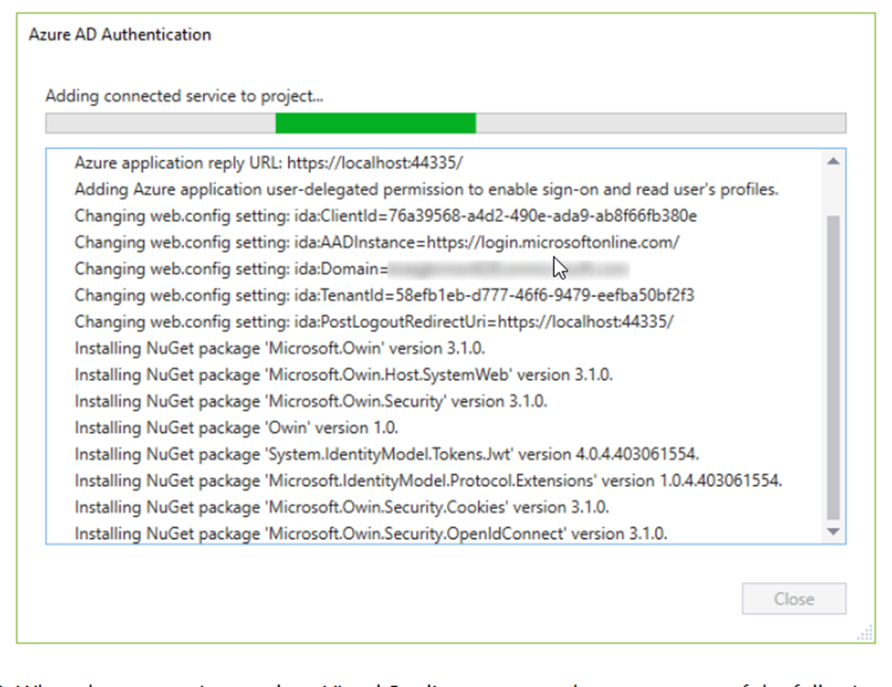
Connected Services

Slide 30
Ignite Orlando 2019

Slide 31
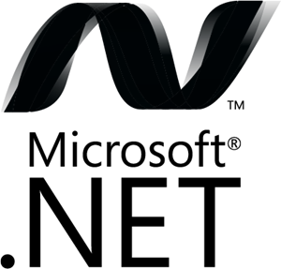
Microsoft Authentication Libraries (MSAL)
Generally Available:
GA
GA
GA
GA
GA
GA
JavaScript
.NET
Android
iOS/macOS
Production Supported Public Preview:
PREVIEW
PREVIEW
Java
Python

Slide 32
It’s EASY and you get stuff for FREE
It’s easy:
Register your app
Use a quickstart
Request permission to data
The rest comes automatically, with no extra code:
single sign on, token management, passwordless, conditional access

Slide 33
Best practice for single sign on
Always try the silent token acquisition before attempting interactive token acquisition!
This simple pattern enables SSO and handling IT policy.
try
{
result = await app.AcquireTokenSilent(scopes, account).ExecuteAsync();
}
catch(MsalUiRequiredException ex)
{
result = await app.AcquireToken(scopes, account).ExecuteAsync();
}

Slide 34
Best practices for secure authentication
Build your solutions by using libraries (MSAL, .NET middleware)
Clients don’t inspect access tokens (only for intended API)
Don’t store login names and passwords. Use MSAL/B2C
Apps shouldn’t handle raw passwords (avoid ROPC)
Confidential clients (daemon, web services) should use certs
Best practices: aka.ms/msidbestpractice

Slide 35
Best practices for updating to MSAL
Write your new apps using MSAL
Update your ADAL apps to MSAL to get the latest innovation
Guides:
aka.ms/UpdateToMSALjs
aka.ms/UpdateToMSALNet
aka.ms/UpdateToMSALAndroid
aka.ms/UpdateToMSALiOSmacOS

Slide 36
Best Practices
Follow the Golden Rules for tokens
Create the best user experience with scopes
Use Roles or Groups
Enable Provisioning
Protect APIs
Protect Services
Protect your apps

Slide 37
Golden Rules for Tokens
Use tokens only for their intended function
ID Tokens identify the user to the application
Access tokens authorize the app for a range of operation for an API
Never mess with someone else’s tokens
Apps do not look at access tokens
APIs never use ID Tokens for authorization
APIs never accept Access Tokens for other APIs
Cache the tokens appropriately
MSAL handles this automatically
There is no endpoint to verify the token

Slide 38
References
https://docs.microsoft.com/en-us/azure/active-directory/develop/
https://docs.microsoft.com/en-us/azure/active-directory/develop/identity-platform-integration-checklist
https://www.youtube.com/watch?v=y_fgJAatVhk&feature=youtu.be
https://medium.com/the-new-control-plane
https://aka.ms/msidplatform
https://developer.microsoft.com/en-us/identity
https://myignite.techcommunity.microsoft.com/sessions/81635

