Slide 1
Identity at Ignite 2020
Rory Braybrook
Microsoft Identity Architect – Microsoft MVP
@rbrayb
https://rbrayb.github.io/Presentations

Slide 2
Azure AD Identity – Key points
Secure Adaptive Access – protect resources and data
Seamless user experience – keep users productive
Unified identity management – keep all colleagues connected to apps and data
Simplified identity governance – automate access controls across hybrid environments

Slide 3
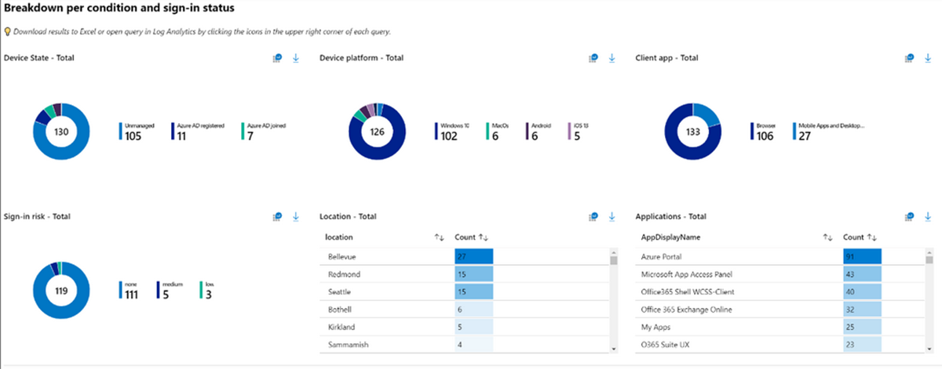
Azure AD - Zero trust - CA

Slide 4
Azure AD - CA
Now has a set of API
Admins can manage all aspects of Conditional Access policies as code, achieving greater scale and automation
Also conditional access for Azure AD B2C
Block legacy authentication by default

Slide 5
Azure AD – Identity Protection
Password Spray detection improvements
Supervised machine learning model which examines over 300 aspects of each authentication request including IP Reputation and behaviour.
Microsoft are catching over 80 Million attacks every day with 98% precision
System automatically adapts to new attacks
https://mysignins.microsoft.com

Slide 6
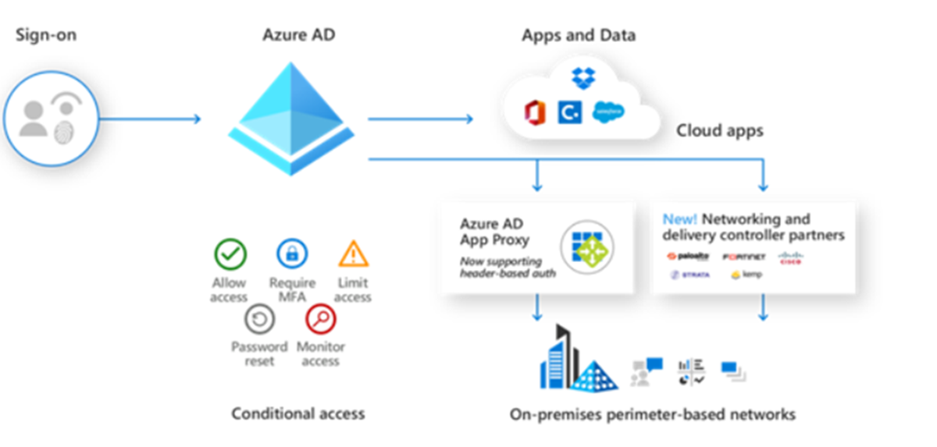
Azure AD App Proxy

Slide 7
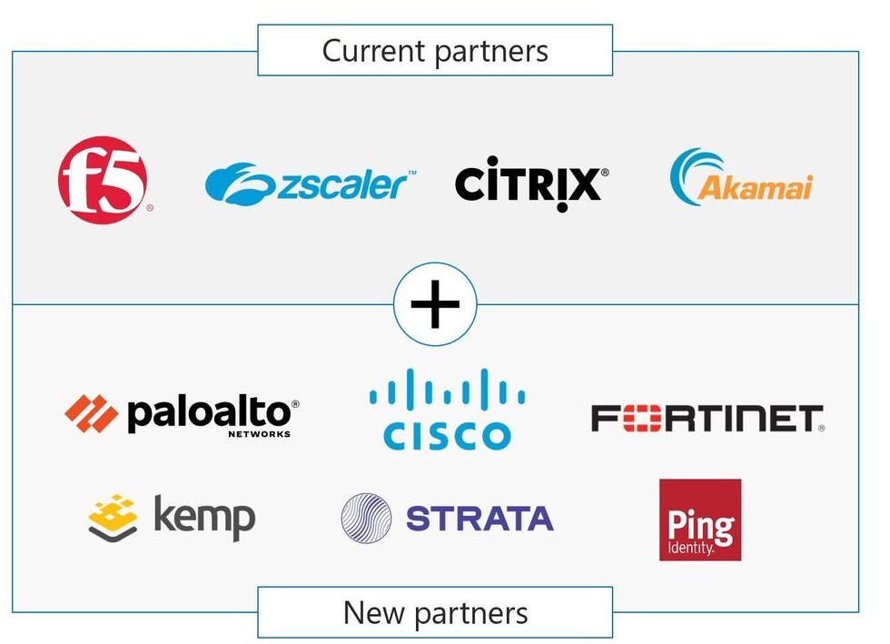
Azure AD App Proxy

Slide 8
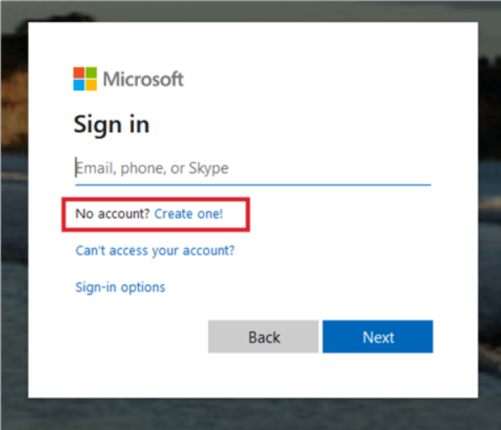
Azure AD – External Identity

Slide 9
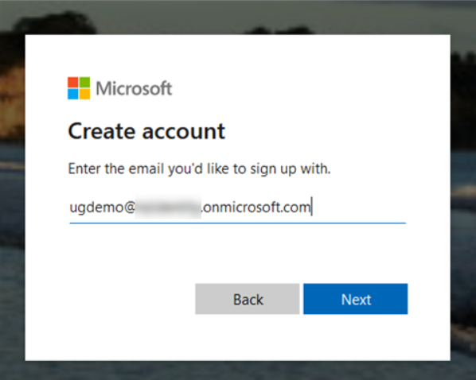
Azure AD – External Identity

Slide 10
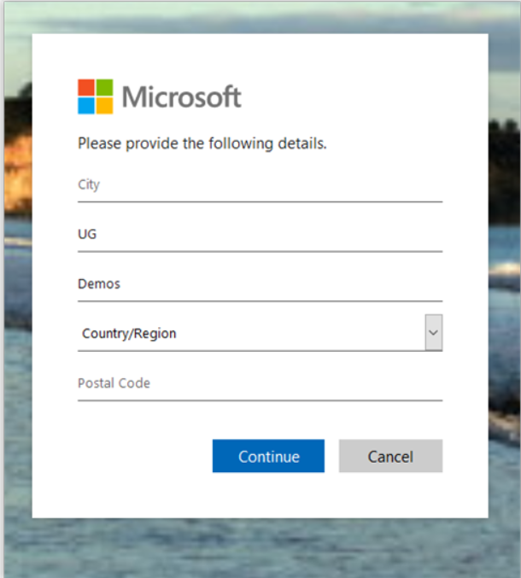
Azure AD – External Identity

Slide 11
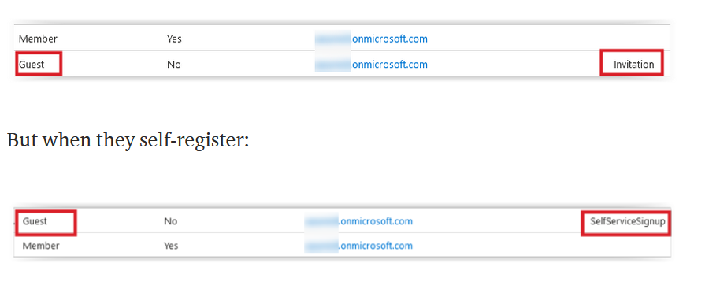
Azure AD – External Identity

Slide 12
Azure AD – External Identity Pricing
Pricing consolidated across:
Azure AD B2C
B2B collaboration
External identities
B2X !!!
First 50,000 monthly active users (MAU) free at both the Premium P1 and Premium P2 tiers

Slide 13
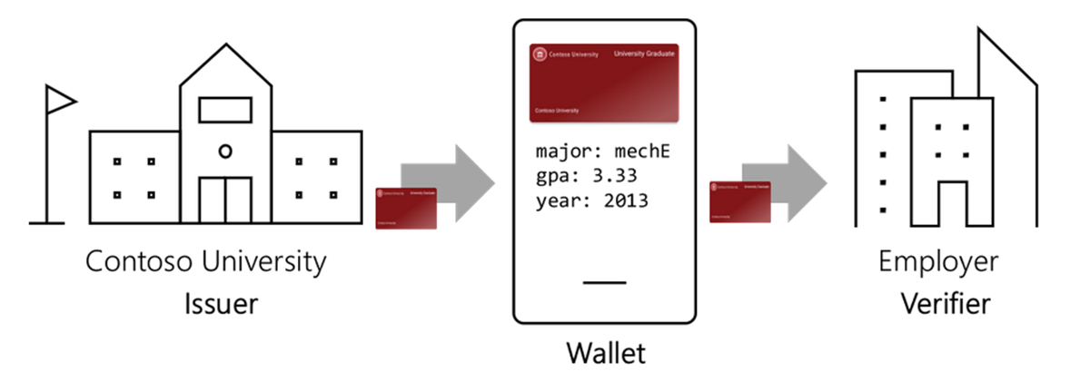
Decentralised Identity: Verifiable credentials

Slide 14
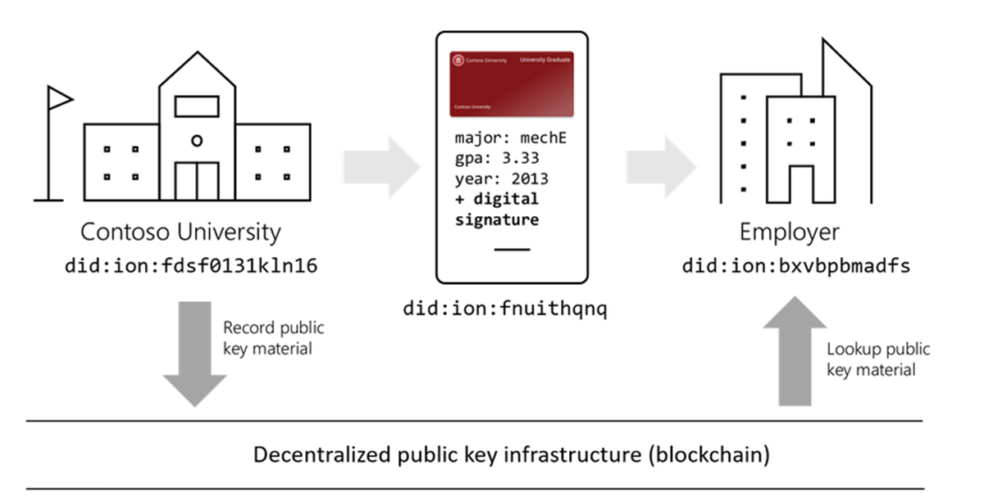
Decentralised Identity: Verifiable credentials

Slide 15
And a bonus!

