Slide 1
The Microsoft Identity jigsaw - putting the pieces together!
Rory Braybrook
Microsoft Identity Architect
Microsoft MVP (Enterprise Mobility)
@rbrayb
https://authory.com/RoryBraybrook

Slide 2
The pieces of the puzzle
Azure AD
Azure AD B2B
Azure AD B2C
Identity Platform
Identity.Web
MSAL

Slide 3
Missing pieces
Azure AD P2
Governance
e.g. PIM
Conditional access
Identity protection
MIM / SCIM
Intune

Slide 4
Azure AD
Basis of M365
Domain joined
Access to SaaS products
Users managed by organisation
Woolworth’s employees

Slide 5
Azure AD B2B
Guest users
Domain joined but in other tenant
Microsoft account / Social
Federation via SAML or WS-Fed
Access to SaaS
Users managed externally
Other companies that do business with Woolworths

Slide 6
Azure AD B2C
Random email address
Non-domain joined
Social / Federation via SAML or OpenID Connect
No access to SaaS
Users self manage
Scales to hundreds of millions of users
Woolworth’s customers

Slide 7
Azure AD B2X
External identities
Migrating Azure AD B2C into Azure AD mainly for B2B users
Pricing is based on monthly active users (MAU), which is the count of unique users with authentication activity within a calendar month. This billing model applies to both Azure AD guest user collaboration (B2B) and Azure AD B2C tenants

Slide 8
The Library Journey
Windows Identity Foundation (WIF)
XML based – web.config – WS-Federation
Windows Identity Foundation (WIF-SAML)
Open Web Interface for .NET (OWIN) – OIDC – “Modern Authentication” - Katana
ADAL / MSAL

Slide 9
The Microsoft Identity Platform

Slide 10
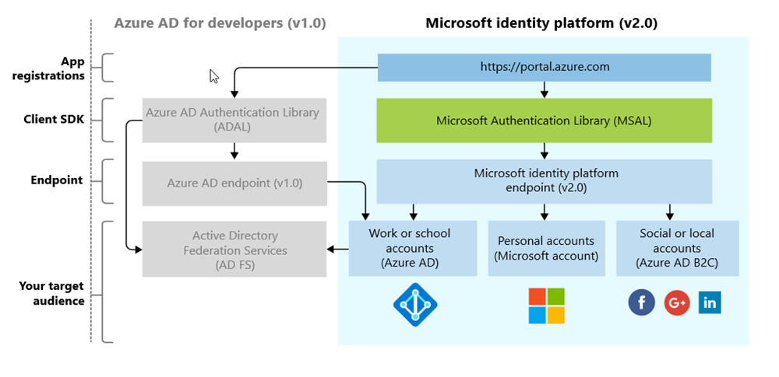
The Platform (not the Product!)

Slide 11
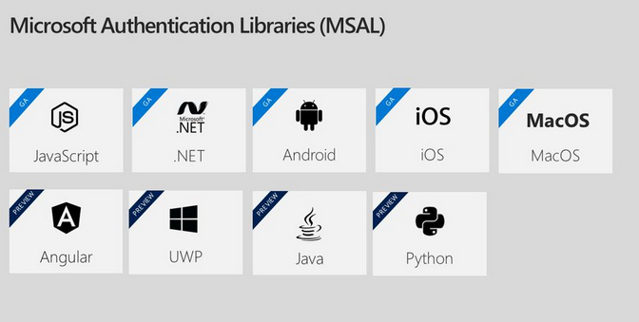
Microsoft Authentication Libraries (MSAL)

Slide 12
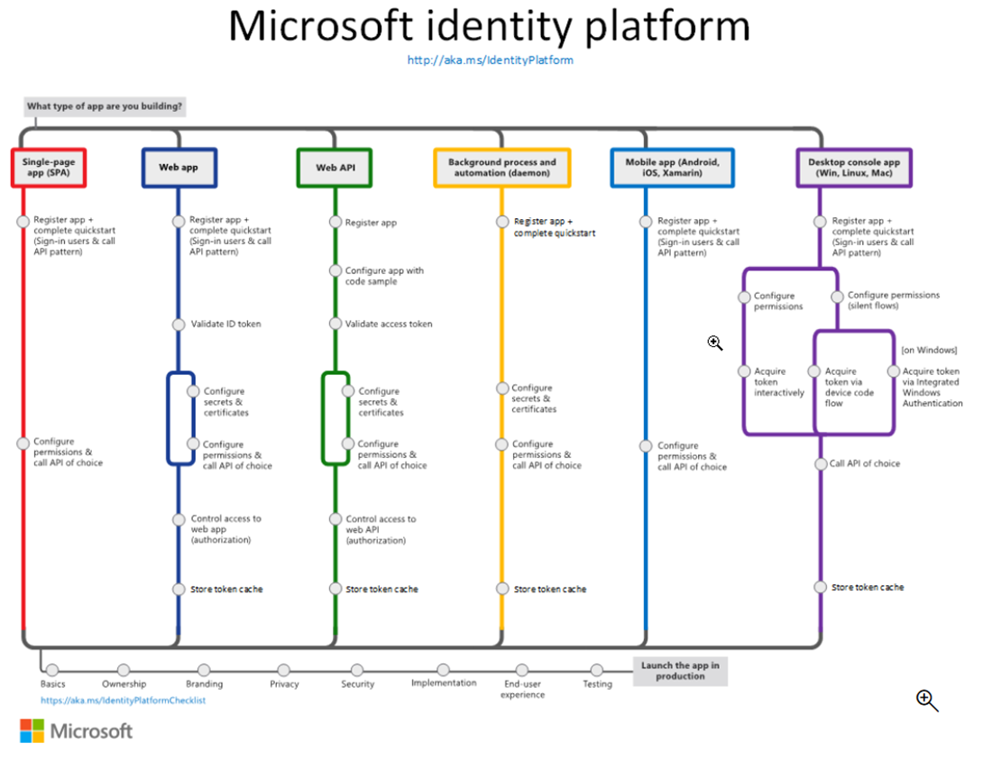

Slide 13
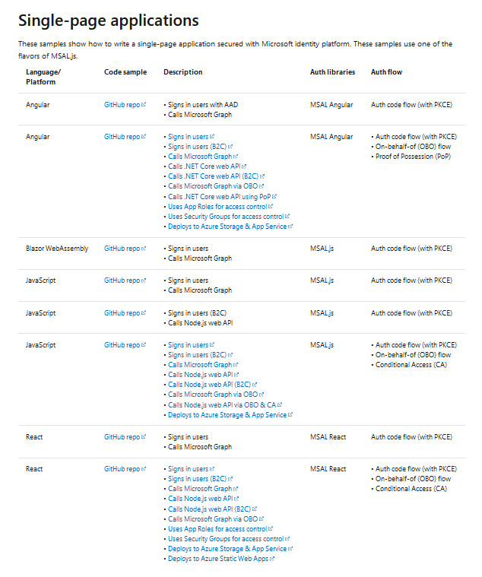
Scenarios SPA

Slide 14
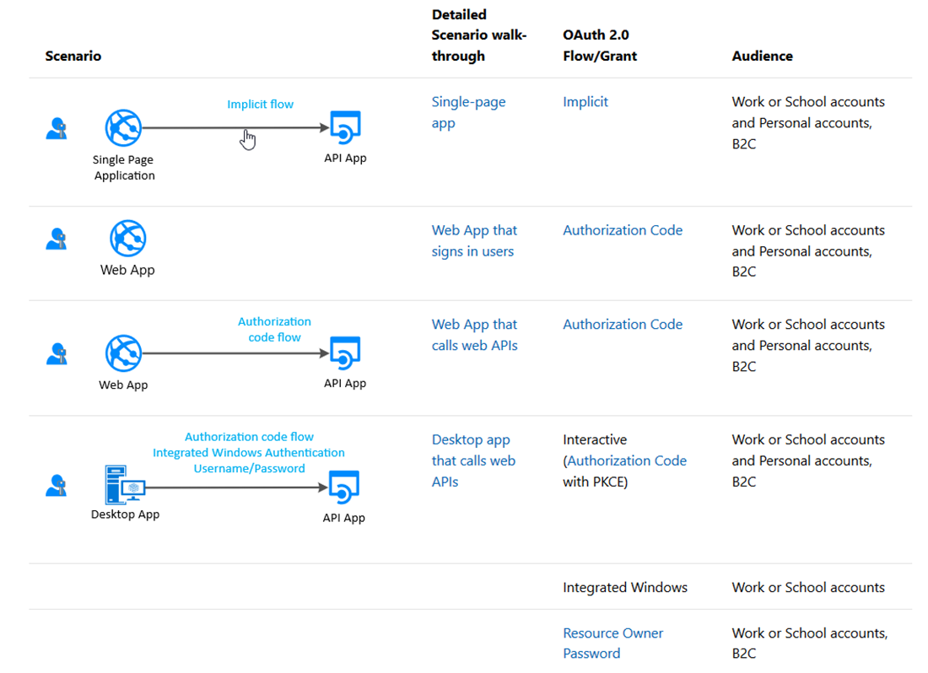
Scenarios

Slide 15
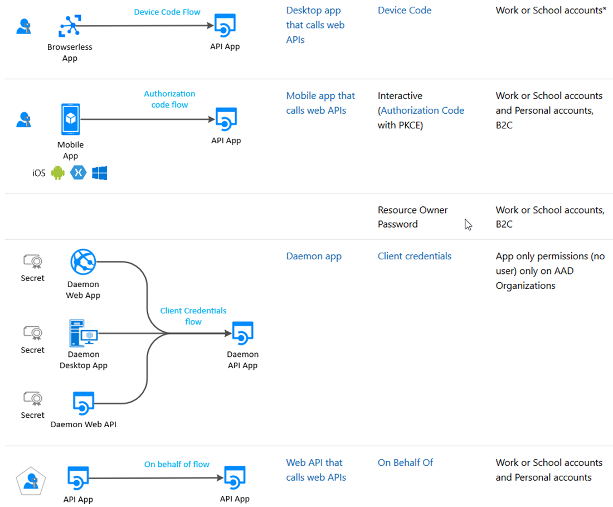
Scenarios

Slide 16
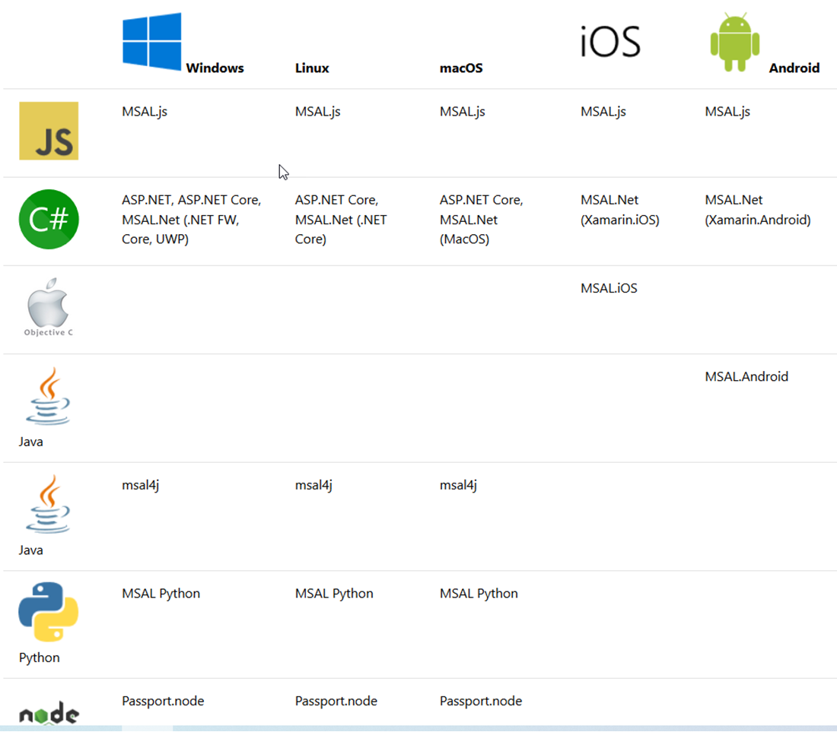
The OS

Slide 17
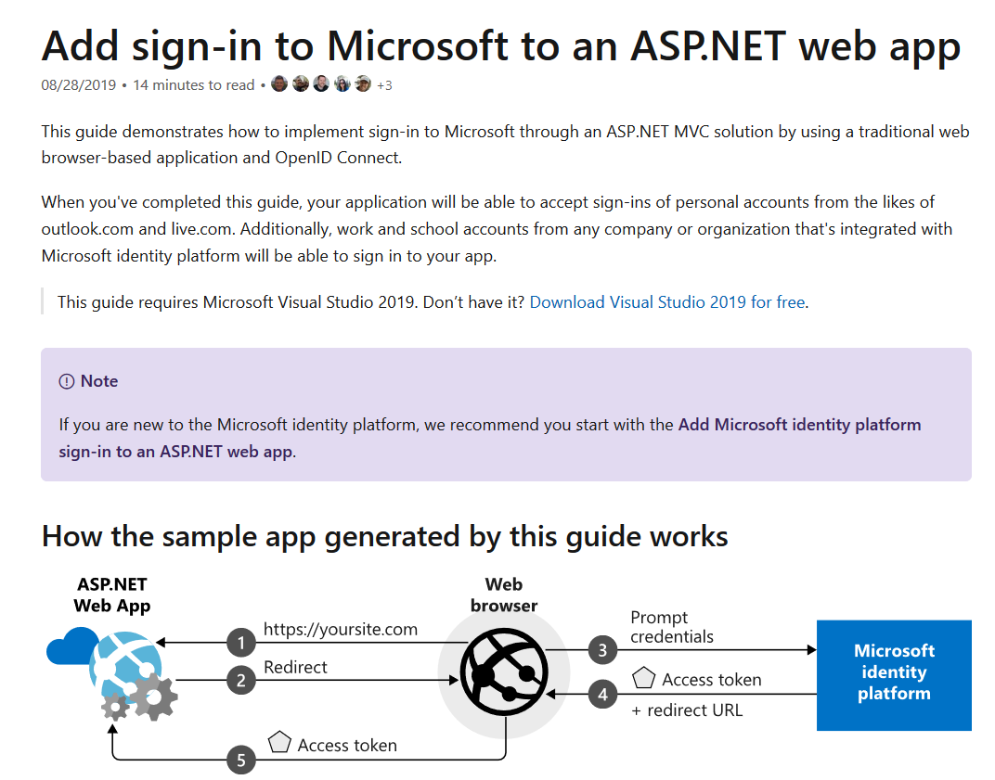
The Guide

Slide 18
Demo’s
Microsoft Identity Platform
B2C built-in policies
B2C custom policies
External identities (B2X!)

Slide 19
Best practices for updating to MSAL
Write your new apps using MSAL
Update your ADAL apps to MSAL to get the latest innovation
Starting June 30th, 2020, no new features for ADAL and @azuread
Graph. Starting June 30th 2022, end of support for ADAL and Azure AD Graph and no more security updates. So start planning to update your applications using MSAL and Microsoft Graph
Guides:
aka.ms/UpdateToMSALjs
aka.ms/UpdateToMSALNet
aka.ms/UpdateToMSALAndroid
aka.ms/UpdateToMSALiOSmacOS

Slide 21
Microsoft.Identity.Web

Slide 22
What is it?
Microsoft Identity Web is a library which contains a set of reusable classes used in conjunction with ASP.NET Core for integrating with the Microsoft identity platform (formerly Azure AD v2.0 endpoint) and AAD B2C
This library is for specific usage with:
Web applications, which sign in users and, optionally, call web APIs
Protected web APIs, which optionally call protected downstream web APIs

Slide 23
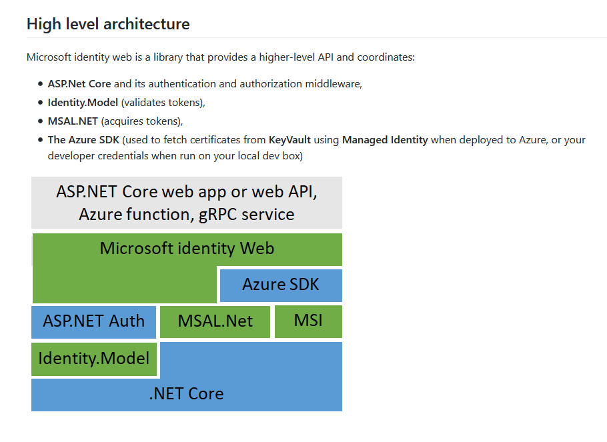
High
level

Slide 24
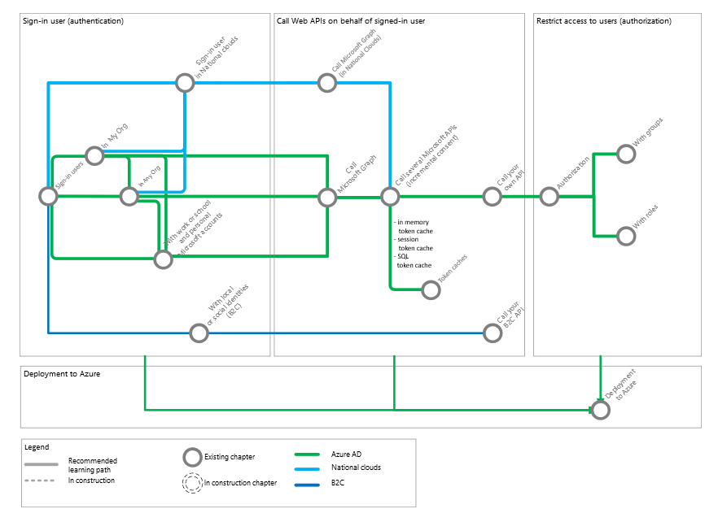
The “subway”

Slide 25
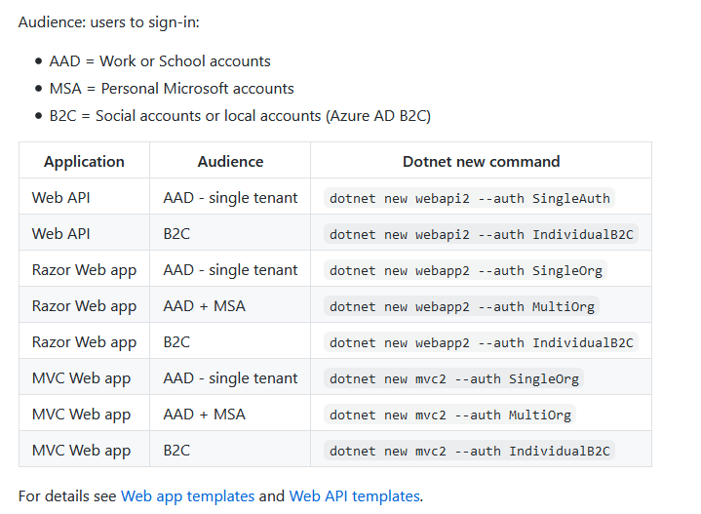
Supported application types

Slide 26
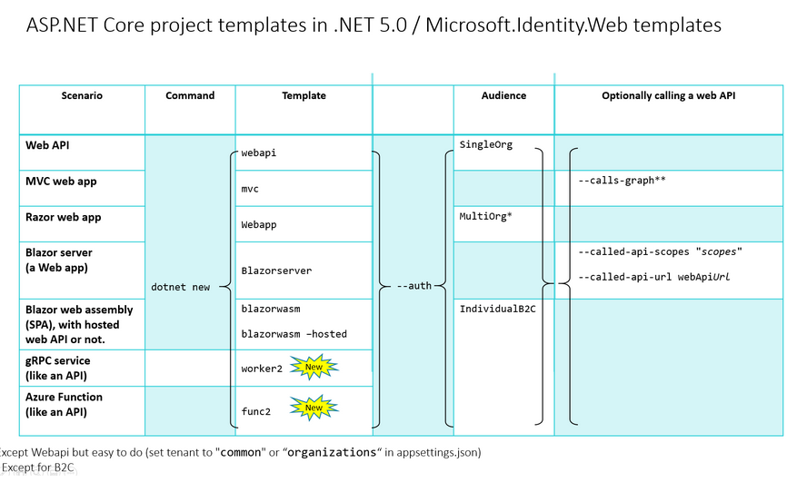
Supported application types

Slide 27
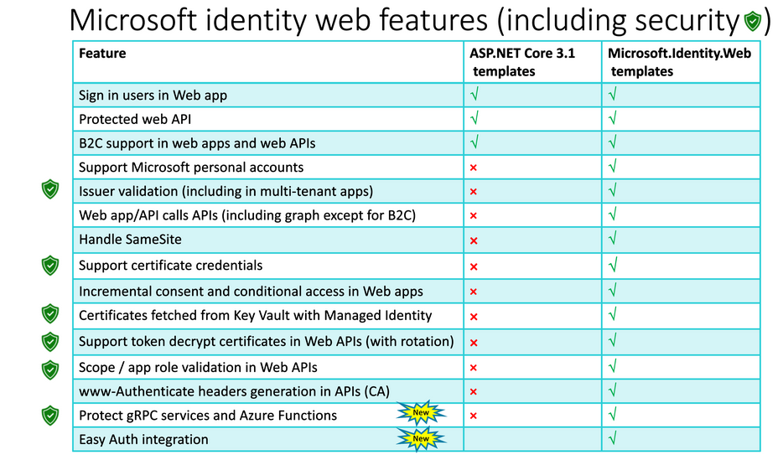
Features

Slide 28
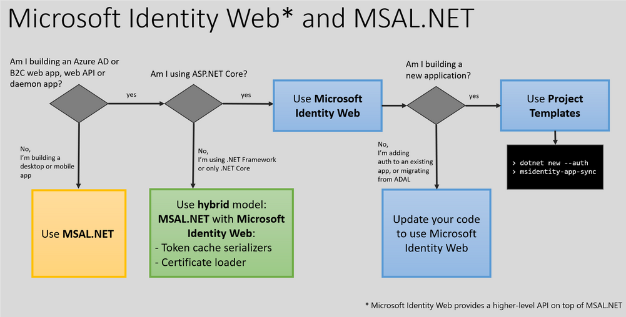
Migration

Slide 29
Demo
Microsoft.Identity.Web

Slide 31
References
https://docs.microsoft.com/en-us/azure/active-directory/develop/
https://docs.microsoft.com/en-us/azure/active-directory/develop/identity-platform-integration-checklist
https://www.youtube.com/watch?v=y_fgJAatVhk&feature=youtu.be
https://medium.com/the-new-control-plane
https://aka.ms/msidplatform
https://developer.microsoft.com/en-us/identity
https://myignite.techcommunity.microsoft.com/sessions/81635

Slide 32
References
https://github.com/AzureAD/microsoft-identity-web
https://github.com/AzureAD/microsoft-identity-web/wiki
https://github.com/Azure-Samples/active-directory-aspnetcore-webapp-openidconnect-v2#scope-of-this-tutorial
https://github.com/Azure-Samples/active-directory-aspnetcore-webapp-openidconnect-v2/tree/master/1-WebApp-OIDC/1-1-MyOrg
https://github.com/Azure-Samples/active-directory-aspnetcore-webapp-openidconnect-v2/tree/master/2-WebApp-graph-user/2-1-Call-MSGraph
https://docs.microsoft.com/en-us/graph/toolkit/overview
https://mgt.dev/?path=/story/components-mgt-agenda--simple
https://docs.microsoft.com/en-us/azure/active-directory/develop/identity-platform-integration-checklist

