Slide 1
The Microsoft Identity jigsaw - putting the pieces together!
Rory Braybrook
Microsoft Identity Architect
Microsoft MVP (Enterprise Mobility)
@rbrayb
https://medium.com/the-new-control-plane

Slide 2
In the beginning …

Slide 3
Defining the Problem Working with identity is too hard
But it appears so easy – a login screen with two textboxes ☺ How hard can that be?
The iceberg scenario – users only see the 10 % “above the surface”
Applications must use different identity technologies in different situations:
Developers don’t understand security – take short cuts
Reinventing the wheel
Different applications use different naming standards for the same identity attribute
Makes security reviews very complex
Why not define one approach that applications can use in all of these cases?
Claims-based identity allows this

Slide 4
Tokens and Claims Representing identity on the wire
A token is a set of bytes that expresses information about an identity
This information consists of one or more claims
Each claim contains some information about the entity to which this token applies
Token
Example Claims
Claim 1
Claim 2
Name
Indicates who created this token and guards against changes
Group
Claim 3
. . .
Age
Claim n
Signature

Slide 5
The Journey
Windows Identity Foundation (WIF)
XML based – web.config – WS-Federation
Windows Identity Foundation (WIF-SAML)
Open Web Interface for .NET (OWIN) – OIDC – “Modern Authentication”

Slide 6
The Microsoft Identity Platform

Slide 7
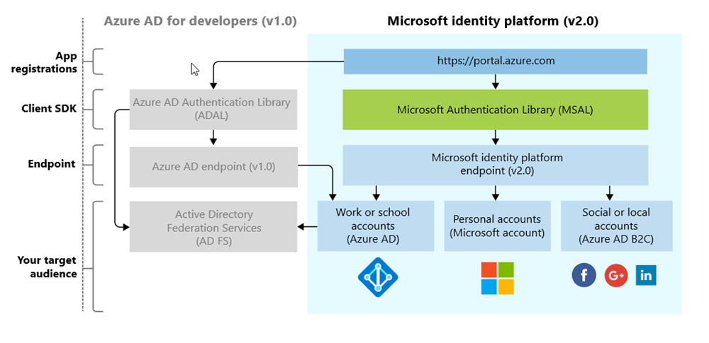
The Platform (not the Product!)

Slide 8
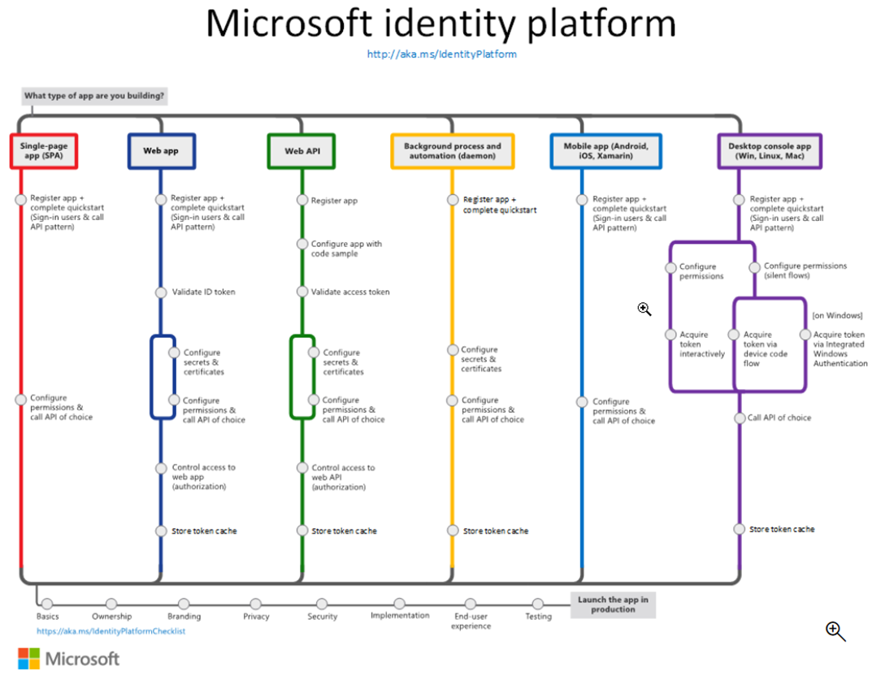

Slide 9
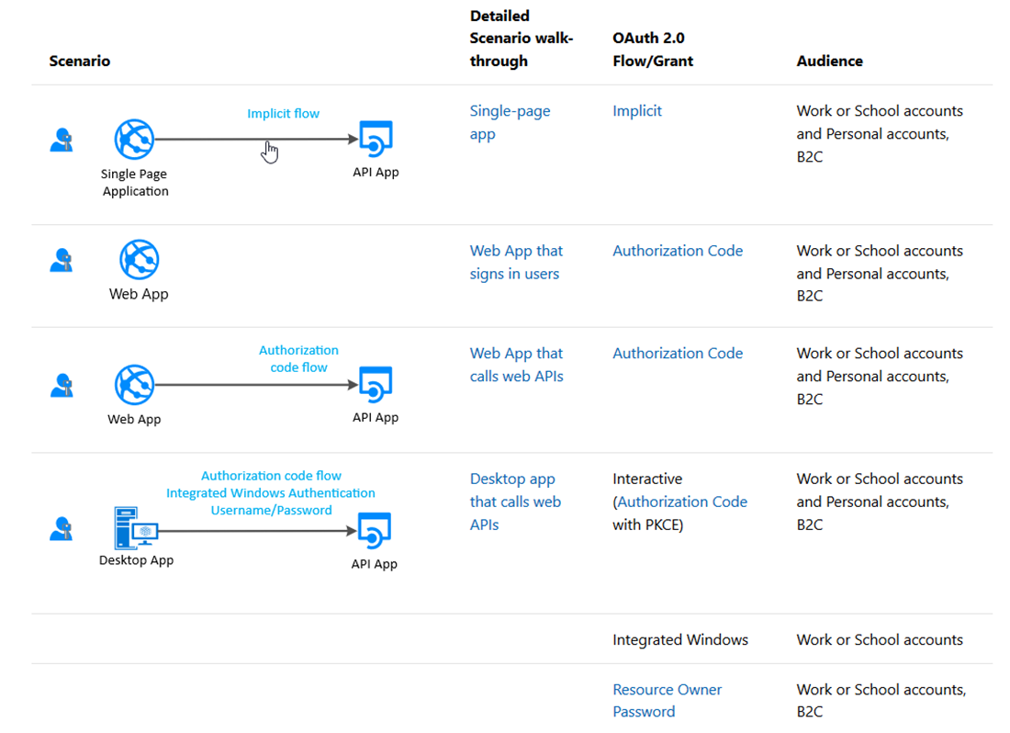
Scenarios

Slide 10
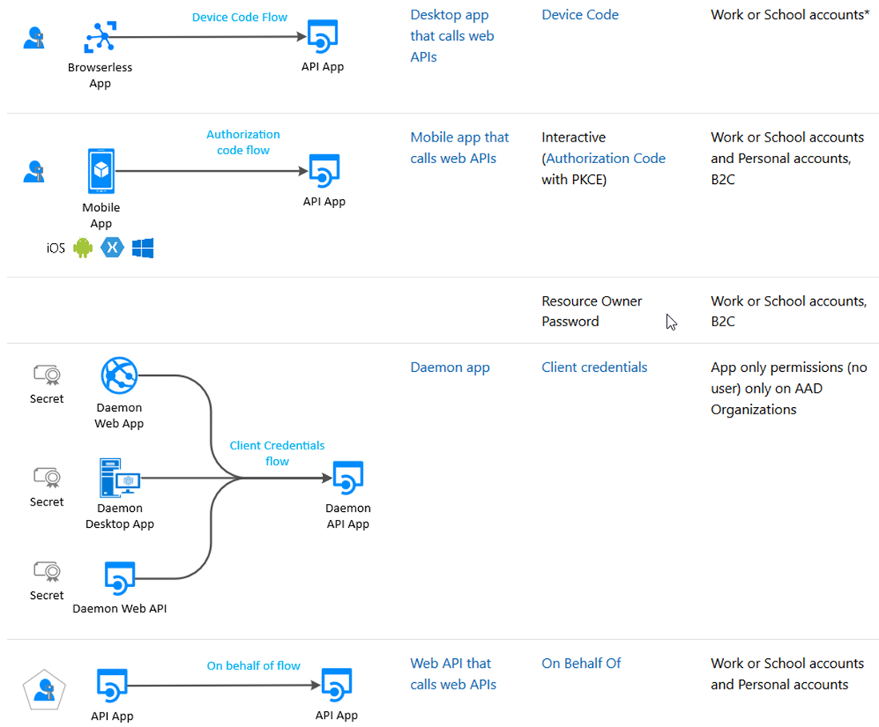
Scenarios

Slide 11
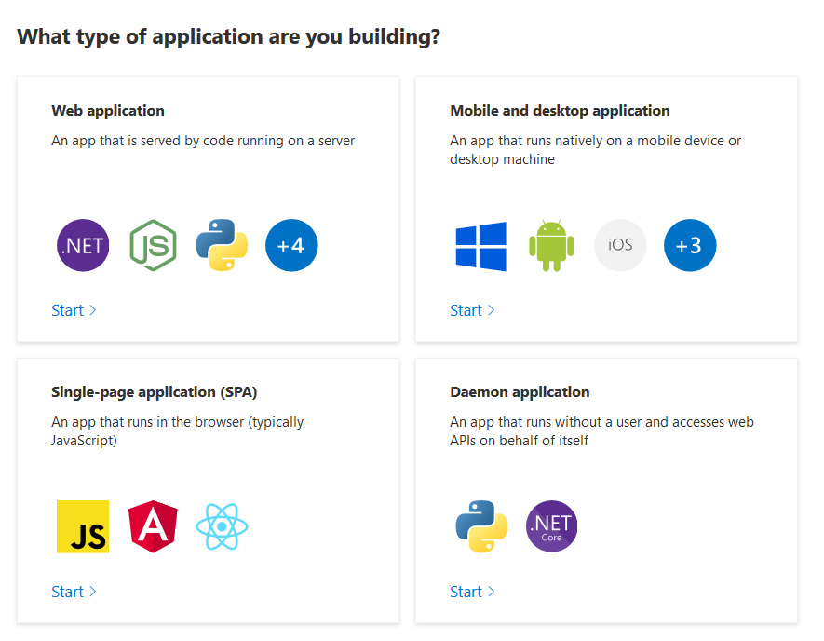
The Format – Type

Slide 12
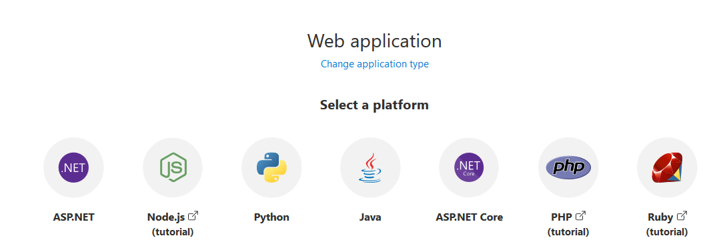
The Format – Web

Slide 13
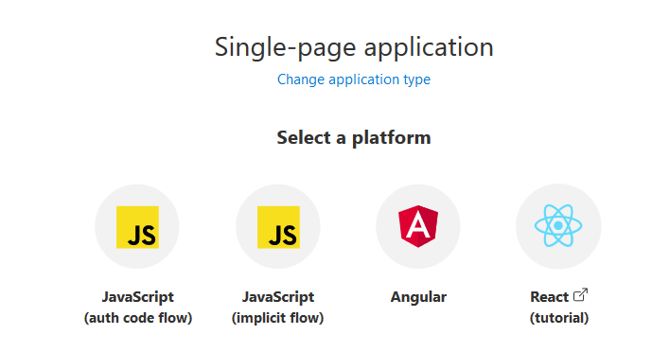
The Format – SPA

Slide 14
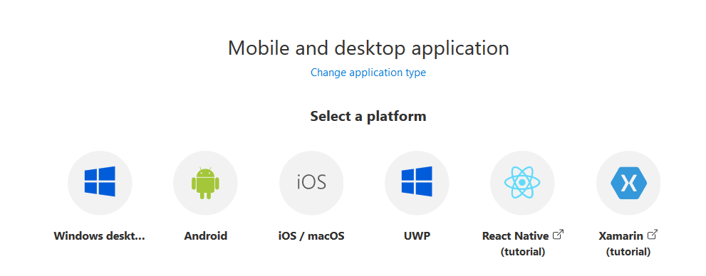
The Format – Native (User)

Slide 15
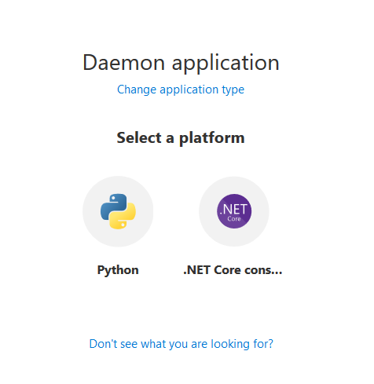
The Format – Native (Application)

Slide 16
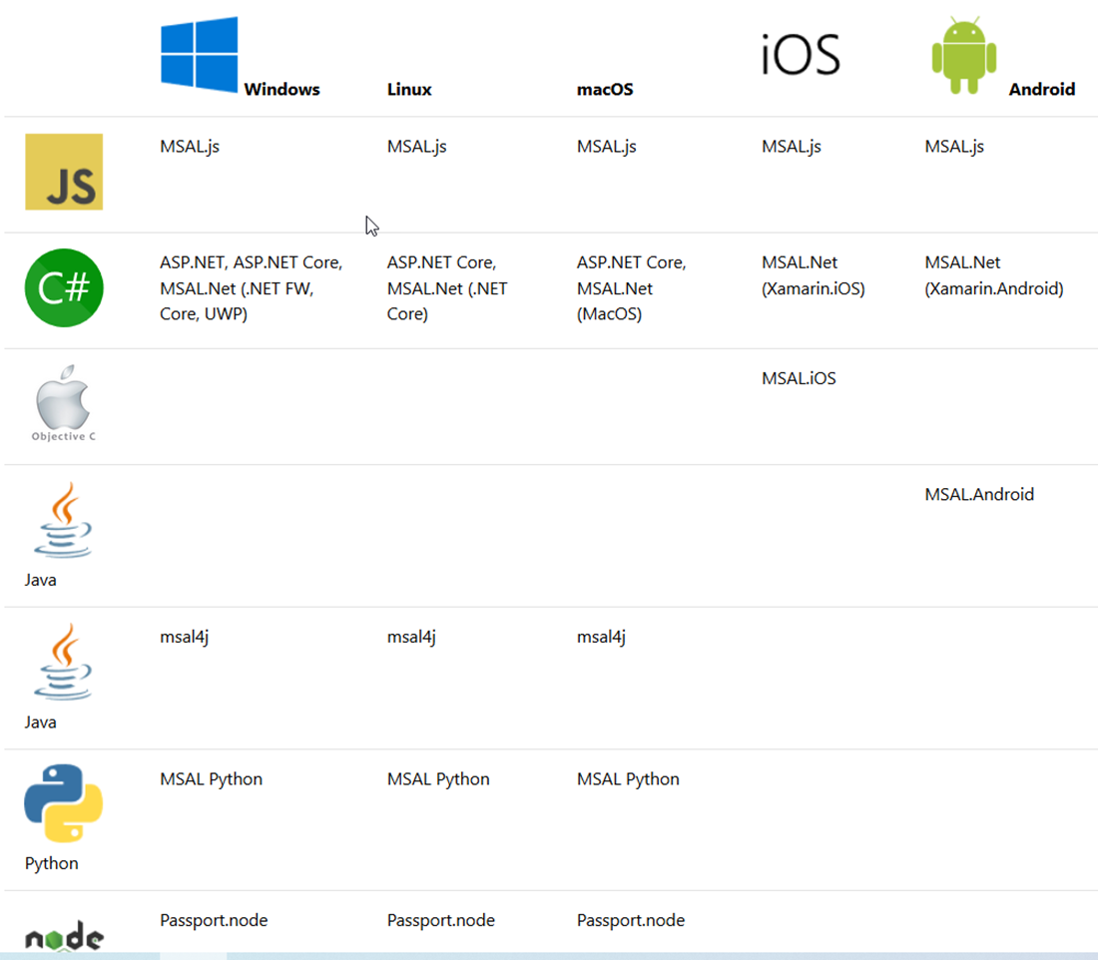
The OS

Slide 17
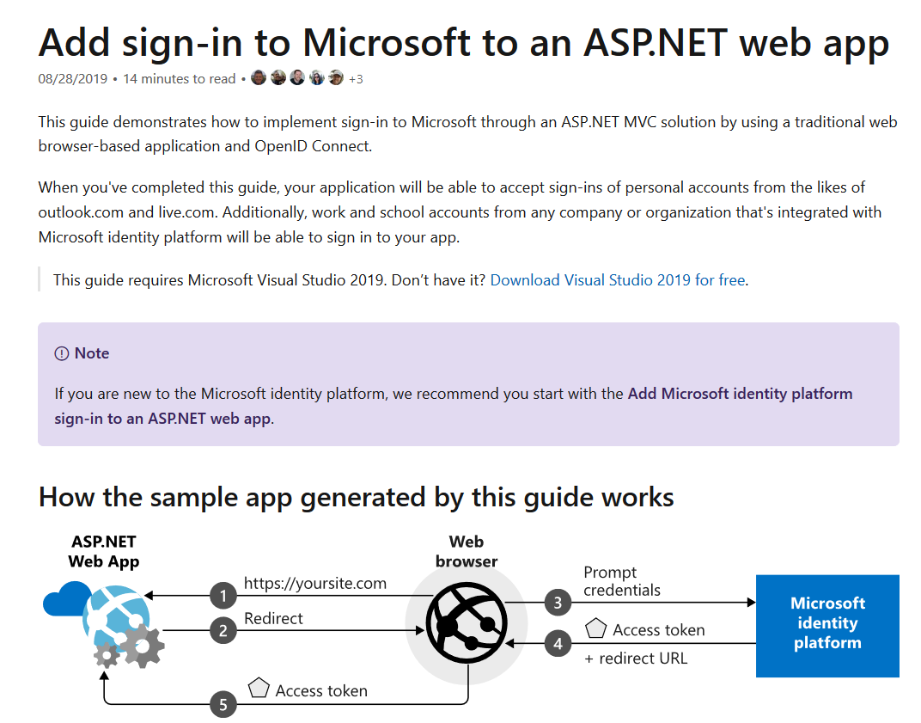
The Guide

Slide 18
Types of tenant
You can restrict the types available by modifying the authority URL.
https://login.microsoftonline.com/common/v2.0
The default, allows any account
https://login.microsoftonline.com/organizations/v2.0
Allow only Azure AD/Office 365 accounts
https://login.microsoftonline.com/consumers/v2.0
Allow only personal MS accounts
https://login.microsoftonline.com/{tenant-id}/v2.0
Allow only a specific Azure AD tenant

Slide 19
Resources / scopes
ADAL
Resource URI
https://graph.microsoft.com
MSAL
Scope
https://graph.microsoft.com/Calendars.Read
Scope=Calendars.Read

Slide 20
The rest
MSAL - ADFS
MSAL connects to Azure AD, which is federated with AD FS
MSAL connects directly to AD FS (Server 2019) (Azure Stack)
Can use ADAL (Samples available)
MSAL – Azure AD B2C
JS
.NET
Samples available

Slide 21
The Demo
The old way
Connected Services
.NET Core B2C
New application registration
Samples

Slide 22
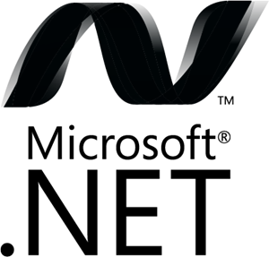
Microsoft Authentication Libraries (MSAL)
Generally Available:
GA
GA
GA
GA
GA
GA
JavaScript
.NET
Android
iOS/macOS
Production Supported Public Preview:
PREVIEW
PREVIEW
Java
Python

Slide 23
It’s EASY and you get stuff for FREE
It’s easy:
Register your app
Use a quickstart
Request permission to data
The rest comes automatically, with no extra code:
single sign on, token management, passwordless, conditional access

Slide 24
Best practices for secure authentication
Build your solutions by using libraries (MSAL, .NET middleware)
Clients don’t inspect access tokens (only for intended API)
Don’t store login names and passwords. Use MSAL/B2C
Apps shouldn’t handle raw passwords (avoid ROPC)
Confidential clients (daemon, web services) should use certs
Best practices: aka.ms/msidbestpractice

Slide 25
Best practices for updating to MSAL
Write your new apps using MSAL
Update your ADAL apps to MSAL to get the latest innovation
Starting June 30th, 2020, no new features for ADAL and @azuread
Graph. Starting June 30th 2022, end of support for ADAL and Azure AD Graph and no more security updates. So start planning to update your applications using MSAL and Microsoft Graph.
Guides:
aka.ms/UpdateToMSALjs
aka.ms/UpdateToMSALNet
aka.ms/UpdateToMSALAndroid
aka.ms/UpdateToMSALiOSmacOS

Slide 27
Microsoft.Identity.Web

Slide 28
What is it?
Microsoft Identity Web is a library which contains a set of reusable classes used in conjunction with ASP.NET Core for integrating with the Microsoft identity platform (formerly Azure AD v2.0 endpoint) and AAD B2C
This library is for specific usage with:
Web applications, which sign in users and, optionally, call web APIs
Protected web APIs, which optionally call protected downstream web APIs

Slide 29
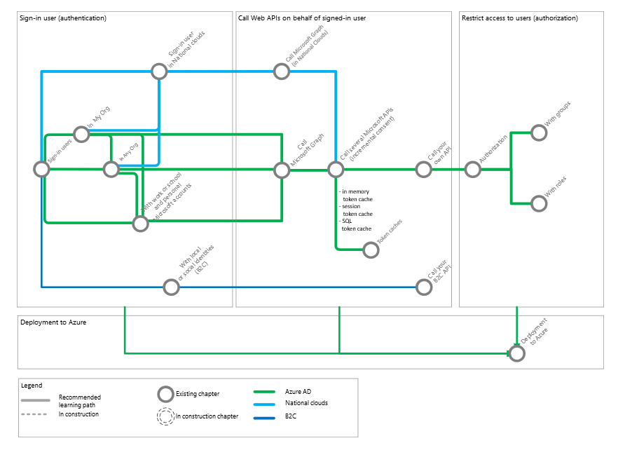
The “subway”

Slide 31
Microsoft Graph Toolkit

Slide 32
What is it?
The Microsoft Graph Toolkit is a collection of reusable, framework-agnostic web components and helpers for accessing and working with Microsoft Graph.
The components are fully functional right of out of the box, with built in providers that authenticate with and fetch data from Microsoft Graph
Web components e.g.
Login
Person
People
Agenda
Providers e.g.
MSAL
SharePoint
Teams

Slide 33
Demo

Slide 35
References
https://docs.microsoft.com/en-us/azure/active-directory/develop/
https://docs.microsoft.com/en-us/azure/active-directory/develop/identity-platform-integration-checklist
https://www.youtube.com/watch?v=y_fgJAatVhk&feature=youtu.be
https://medium.com/the-new-control-plane
https://aka.ms/msidplatform
https://developer.microsoft.com/en-us/identity
https://myignite.techcommunity.microsoft.com/sessions/81635

Slide 36
References
https://github.com/AzureAD/microsoft-identity-web
https://github.com/Azure-Samples/active-directory-aspnetcore-webapp-openidconnect-v2#scope-of-this-tutorial
https://github.com/Azure-Samples/active-directory-aspnetcore-webapp-openidconnect-v2/tree/master/1-WebApp-OIDC/1-1-MyOrg
https://github.com/Azure-Samples/active-directory-aspnetcore-webapp-openidconnect-v2/tree/master/2-WebApp-graph-user/2-1-Call-MSGraph
https://docs.microsoft.com/en-us/graph/toolkit/overview
https://mgt.dev/?path=/story/components-mgt-agenda--simple
https://docs.microsoft.com/en-us/azure/active-directory/develop/identity-platform-integration-checklist

