Slide 1
WebAuthn
Rory Braybrook
Microsoft Identity Architect
@rbrayb
https://rbrayb.github.io/Presentations

Slide 2
News
Your Pa$$word doesn't matter
Authentication Methods–Usage & Insights
Azure AD B2B collaboration direct federation with SAML and WS-Fed
Use Azure Active Directory B2C to enable “Sign in with Apple”
Identity Secure Score is now generally available!

Slide 3
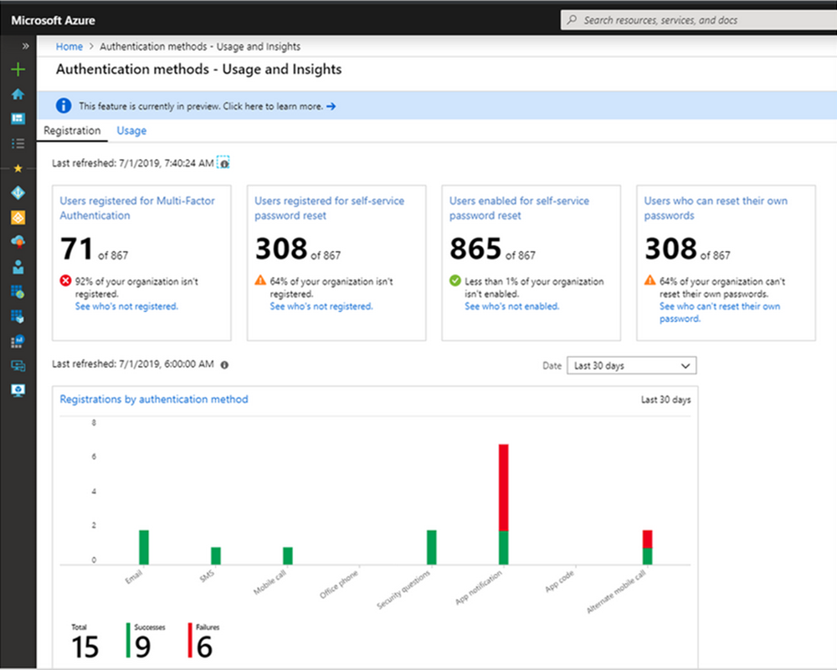

Slide 4
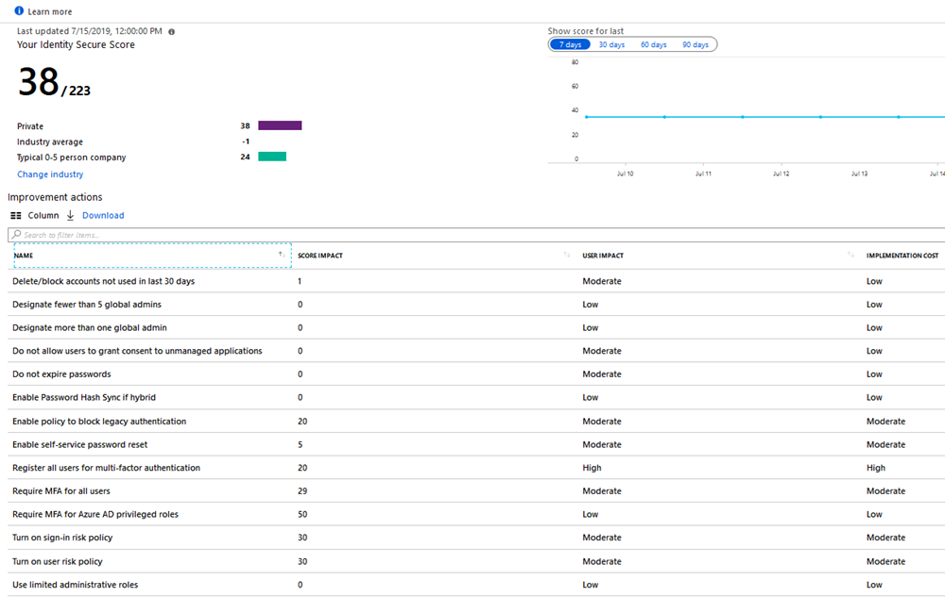

Slide 5
Why passwordless?

Slide 6
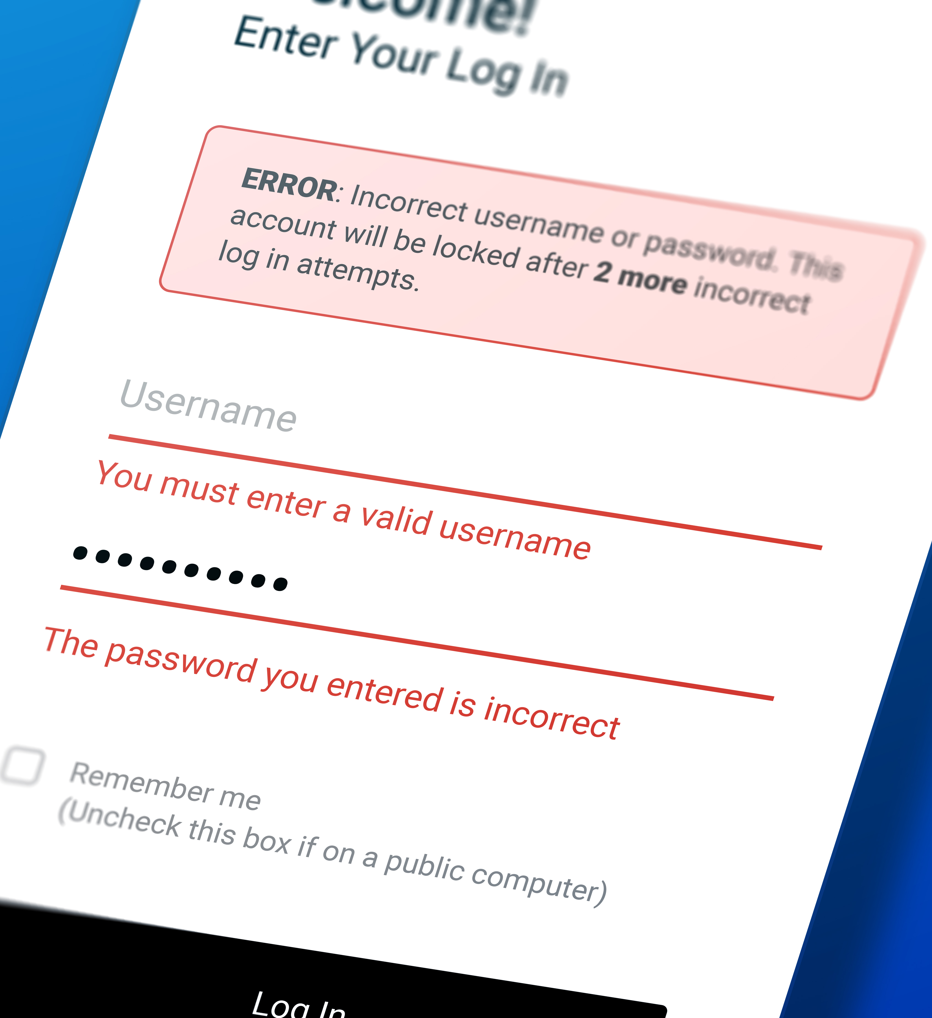
Passwords are frustrating to use
Alpha-numeric passwords are hard to remember
On mobile devices passwords are impossible to enter
Even the strongest passwords are easily phishable
Microsoft Confidential

Slide 7
Passwords are expensive and insecure
Password reuse across multiple accounts
Passwords are the weak link
Data breaches are expensive
Passwords generate tons of support calls
73%
of passwords are duplicates
81%
of breaches leveraged passwords
$3.86
million, the average total cost of a data breach
#1 cost
for IT departments is forgotten passwords

Slide 8
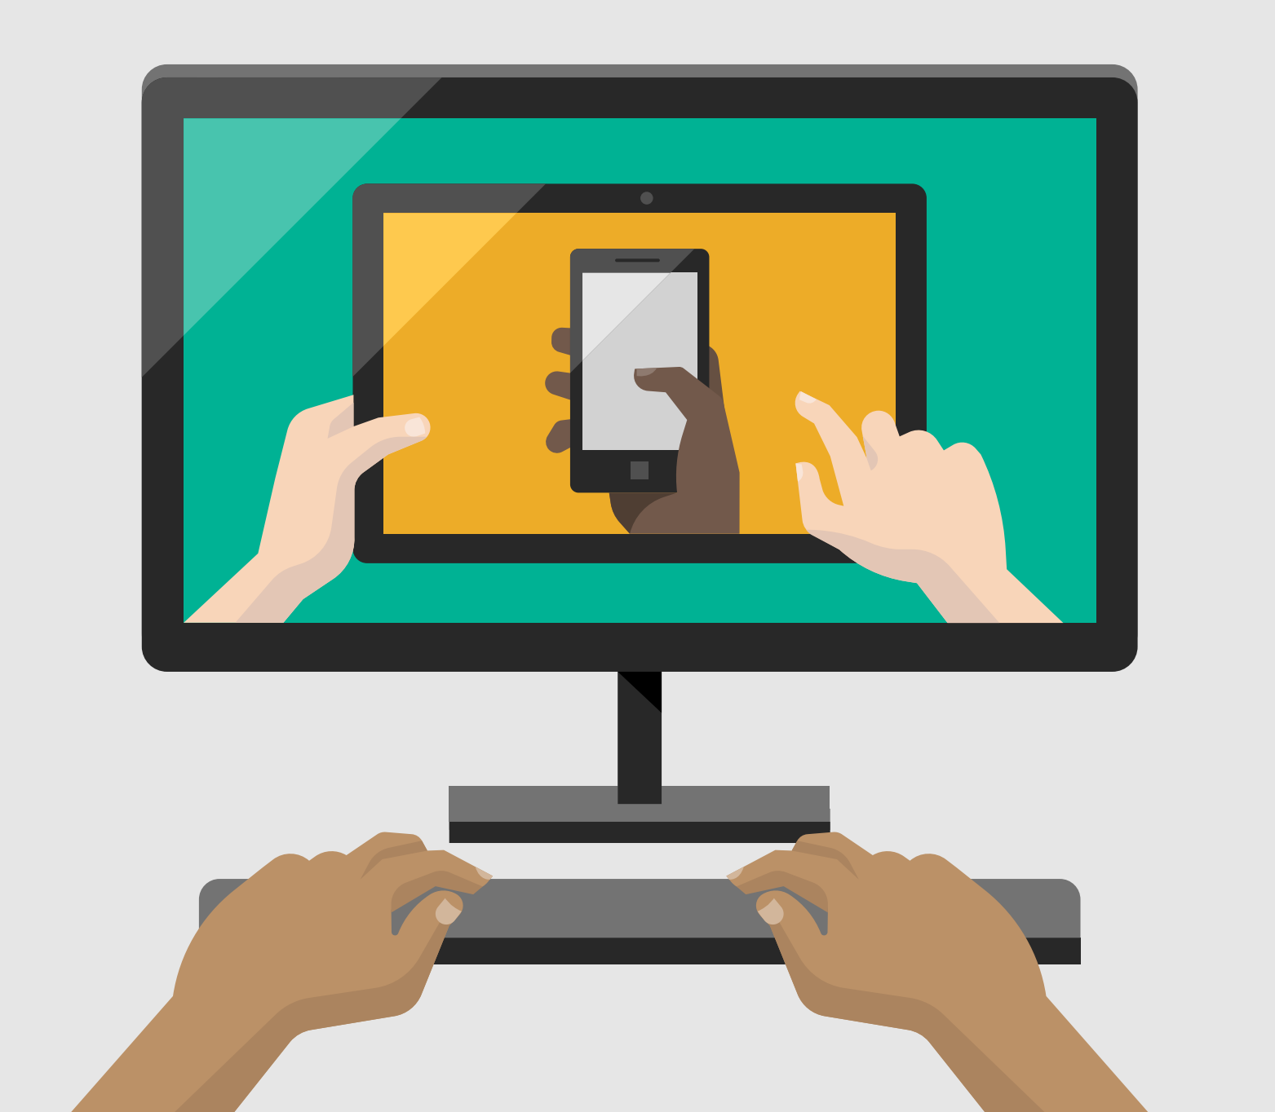
What do passwords mean for apps & services?
Onboarding friction
User drop off
Risk of account compromise

Slide 9
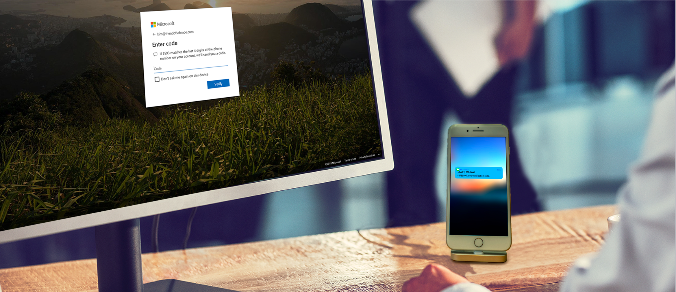
What about multi-factor authentication?
Passwords + MFA more secure, but also more complicated to use.

Slide 10
Microsoft’s passwordless strategy?

Slide 11
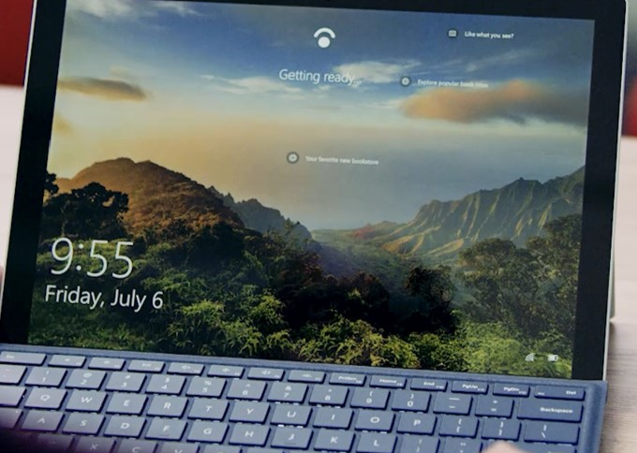
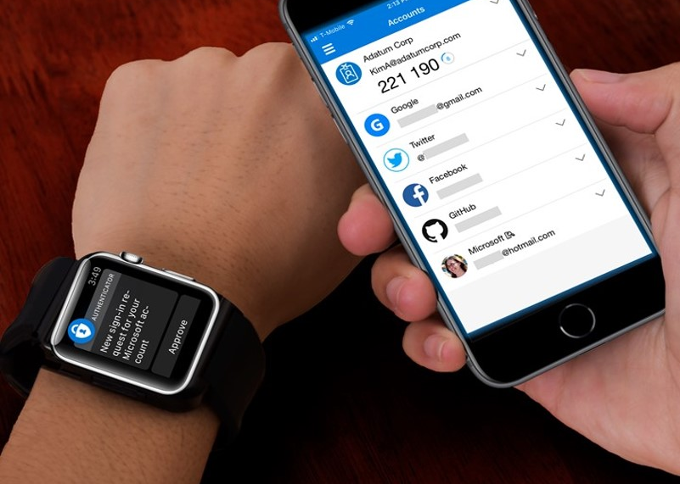
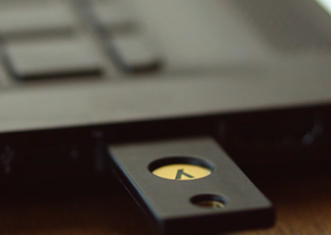
Microsoft’s password-replacement offerings
Standards-based private key authentication that is convenient and more secure than a password
Windows Hello for Business
Microsoft Authenticator
Microsoft compatible security keys (FIDO2)

Slide 12
Microsoft’s Passwordless strategy
Achieve security promise
Achieve end-user promise
4
3
Eliminate passwords from identity directory
2
Transition to passwordless deployment
1
Reduce user-visible password surface area
Deploy password- replacement offerings

Slide 13
FIDO2 Authentication

Slide 14
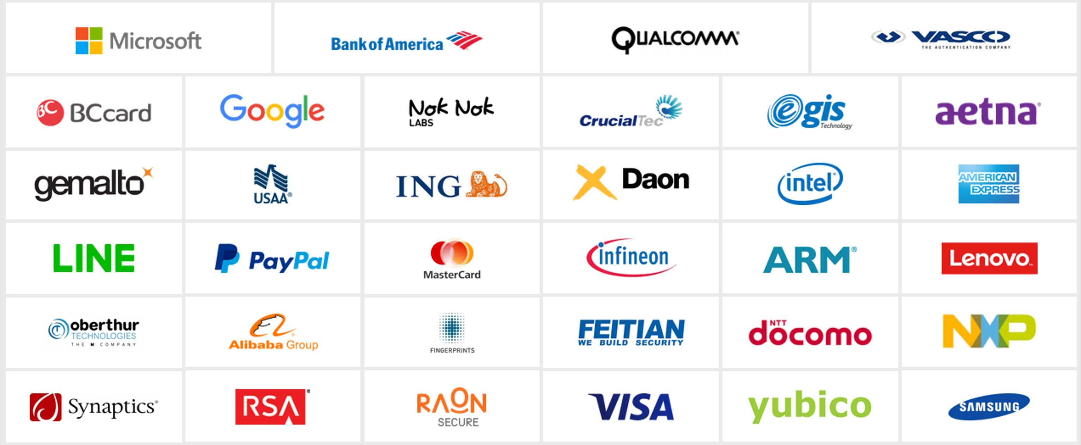
FIDO Ecosystem
…and many other industry partners

Slide 15
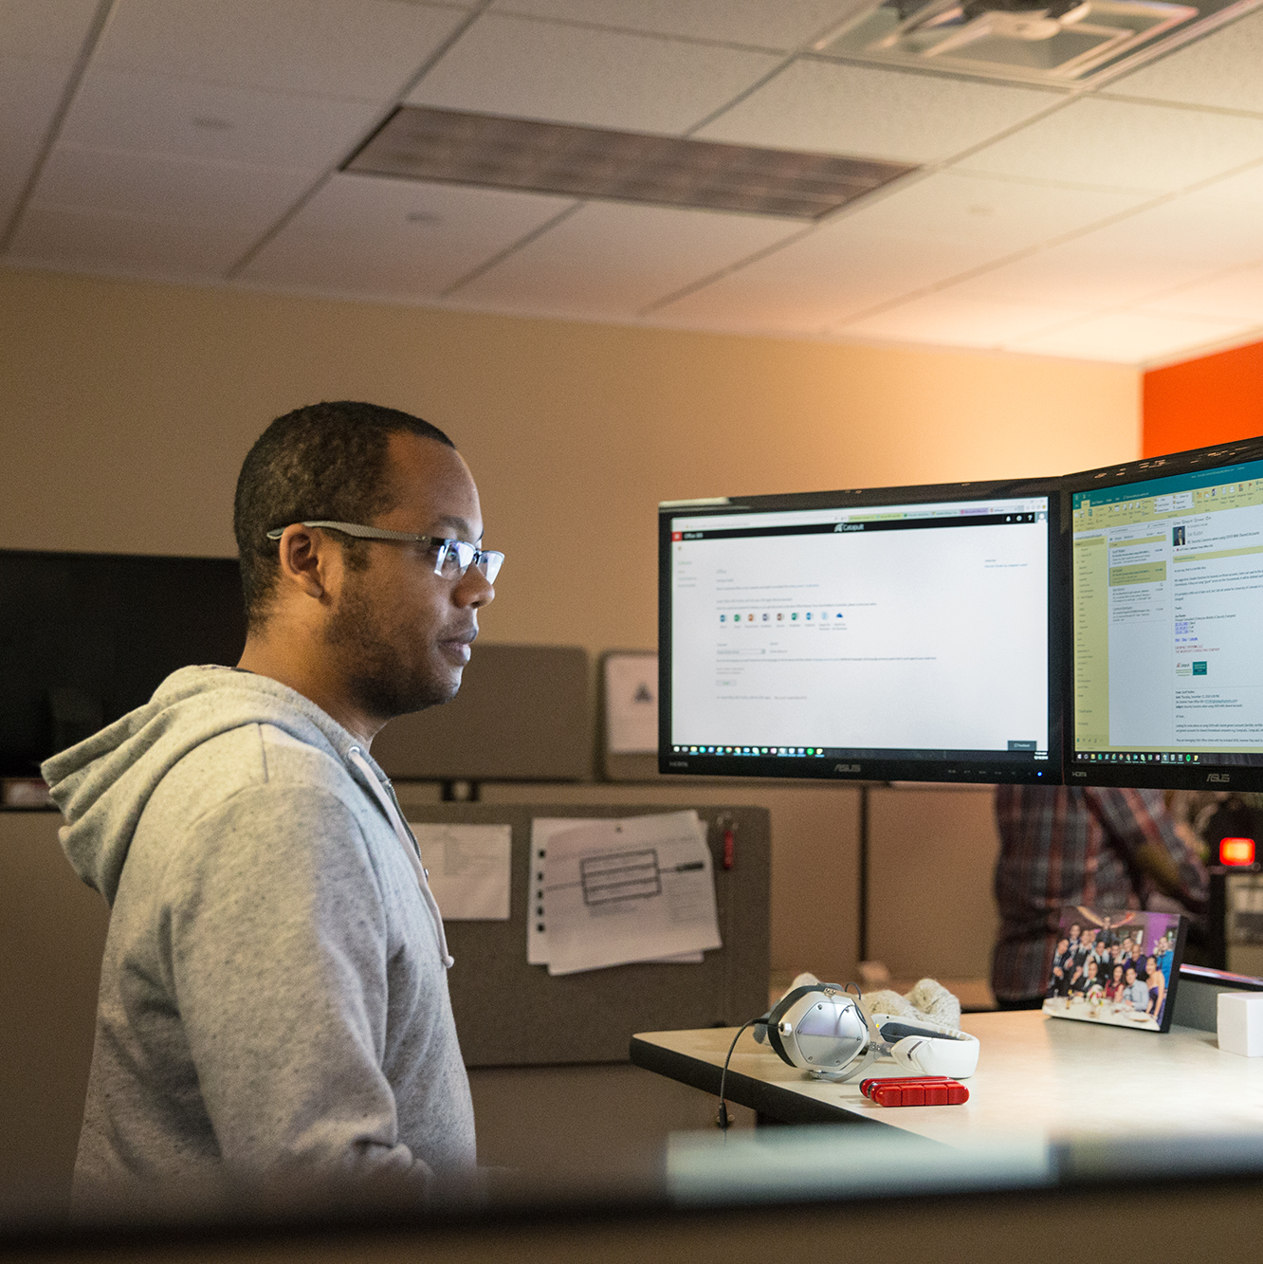
FIDO2 Framework
Open standard for providing strong authentication
Enables passwordless multi-factor authentication and can be used for traditional second factor scenarios (U2F)

Slide 16
FIDO2 Goals
Strong Auth
Non-phishable
Non-breachable
Non-replayable
Cryptographic proof of nature of credentials through attestation
Improved Usability with convenient user gestures
Preserve user privacy through isolation of identities
Scalability through simple Javascript API support

Slide 17
FIDO2 Specifications
FIDO2 is comprised of multiple standards that work together to enable stronger authentication:
W3C Web authentication (WebAuthn)
Client to authenticator protocol (CTAP2)

Slide 18
User authentication

Slide 19
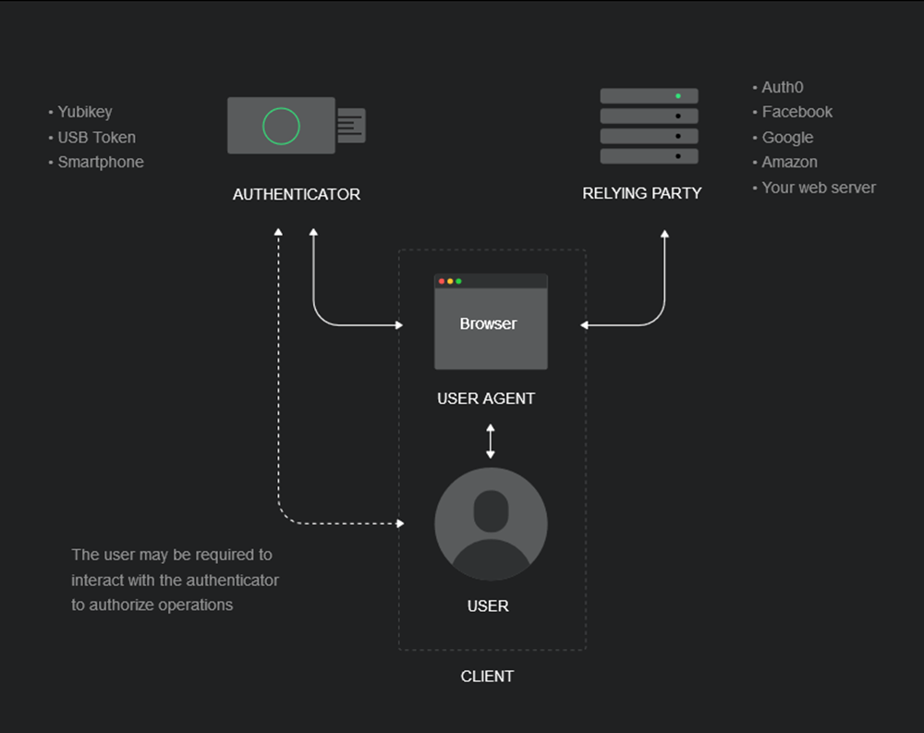
Actors

Slide 20
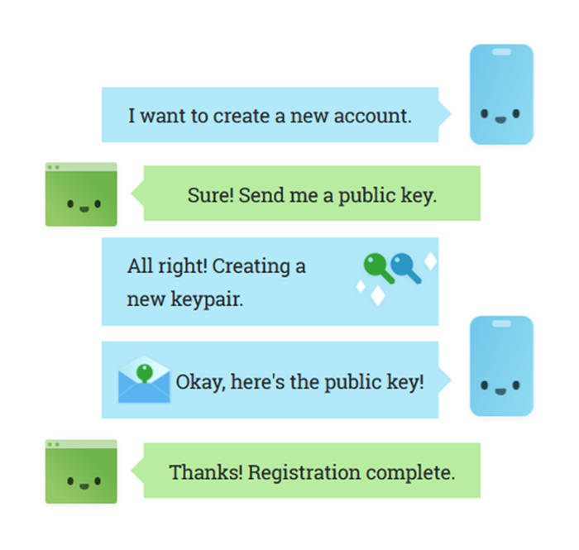
Register

Slide 21
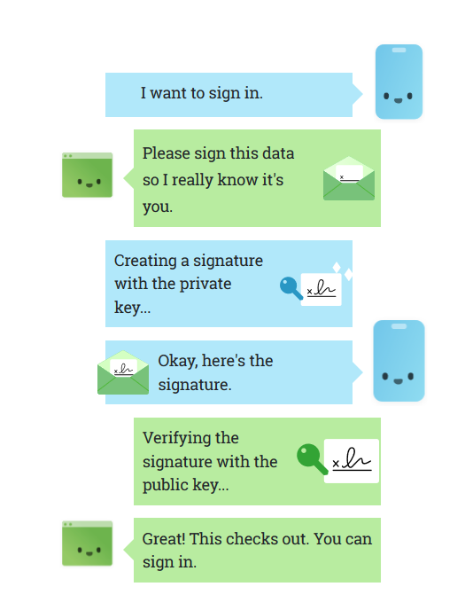
Authenticate

Slide 22
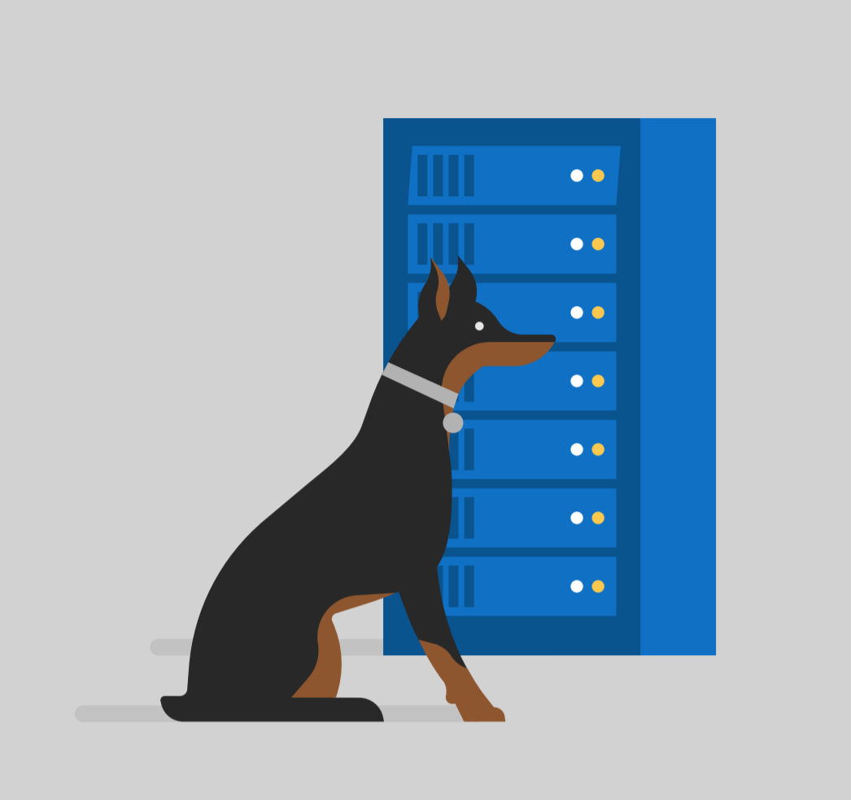
User authentication
1. Send challenge
2. Provide user verification
RP Server
FIDO2 Authenticator
3. Sign and return challenge
User Auth gestures
4. Verify signed challenge

Slide 23
WebAuthn API

Slide 24
Using the WebAuthn API
Two basic steps
Register an authenticator credential with create API
Authenticate a user with the get API
navigator.credentials.create({ publicKey: publicKeyCredentialCreationOptions })
navigator.credentials.get({ publicKey: publicKeyCredentialRequestOptions })

Slide 25
Browser support
Edge
Firefox 66+
Chromium based browsers (coming soon)

Slide 26
Azure AD
Cloud only
No ADFS
No MFA server (Aside – now deprecated!)
AAD Join only
No Hybrid AD Join

Slide 27
Azure AD public preview

Slide 28
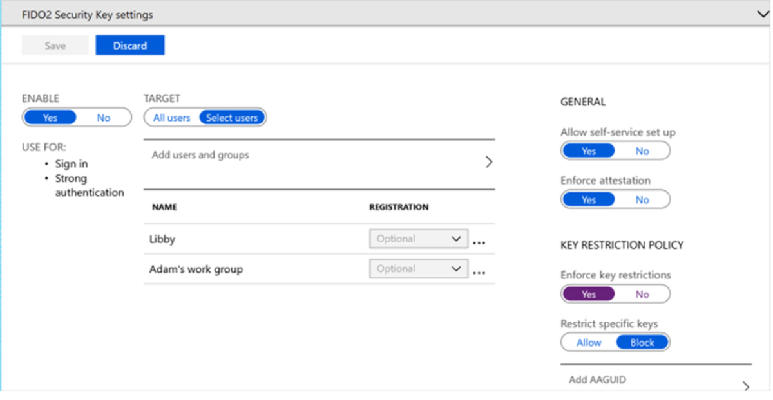
FIDO2

Slide 29
Converged registration portal for your users to manage keys

Slide 30
WebAuthn resources
FIDO2 Overview
https://fidoalliance.org/specs/fido-v2.0-rd-20170927/fido-overview-v2.0-rd-20170927.html
WebAuthn specification
https://www.w3.org/TR/webauthn
WebAuthn sample
https://github.com/MicrosoftEdge/webauthnsample
Other
https://webauthn.me
https://medius.studios.ms/video/asset/PPT/B19-BRK3084
https://webauthn.guide
https://webauthn.io/

Slide 31
n resources
FIDO2 Overview
https://fidoalliance.org/specs/fido-v2.0-rd-20170927/fido-overview-v2.0-rd-20170927.html
WebAuthn specification
https://www.w3.org/TR/webauthn
WebAuthn sample
https://github.com/MicrosoftEdge/webauthnsample
WebAuthn example
https://webauthn.guide/

