Slide 1
The Apollo Guidance Computer
Rory Braybrook
@rbrayb

Slide 2
Spoiler Alert
Media !!!

Slide 3
The beginning

Slide 4
Sputnik - 4 October 1957

Slide 5
Sputnik - 4 October 1957

Slide 6
Flopnik - December 6, 1957

Slide 7
Alan Shepherd - May 5, 1961

Slide 8
JFK - Address to Congress - May 25, 1961

Slide 9
We need a computer The “state” of the PC

Slide 10
Altair 8800 - 1974

Slide 11
Apple 1 - 1976

Slide 12
TRS 80 - 1977

Slide 13
IBM PC - 1981

Slide 14
NASA mainframe - 1960

Slide 15
MIT

Slide 16
Charles Draper lab
MIT chosen because they developed the guidance system for the Polaris missile.
MIT contract with NASA – “develop a navigation, control, and guidance system that would be carried by both the Apollo command module and the lunar lander”.
No detailed requirements.

Slide 17
The AGC

Slide 24
Weaving the rope

Slide 26
AGC stats
5 interrupts
1 Mhz clock
16 bit words
2048 words RAM
36K words ROM (with banked memory)
17 registers
Weighs 70 lbs
Draws 55 watts
First to use IC (Fairchild)
A full decade prior to the first commercially available microprocessor – the 4-bit Intel 4004 central processing unit (CPU) was released in 1971

Slide 27
Words
Words were 16 bits long - used to represent either data or instructions
Only 15 bits are actually usable (the 16th bit is a parity bit for error checking)
First three bits store an operation code (or “opcode”)
Remaining 12 bits to store an address.
Three bits for the opcode = eight opcodes.
Could sometimes use the fourth bit as part of the op code as well (this required calling an EXTEND instruction first, so the computer would know the following instruction had a special four-bit opcode).

Slide 28
“OS”
Exec - managed jobs based on priority.
Could run up to eight tasks at a time with each task periodically checking back with the Exec to see if a task with a higher priority was waiting to run.
The Waitlist held tasks waiting for the Exec to have capacity to run them.
Restart parameters (current state) were saved periodically – allowed for restart not reset.

Slide 29
Interpreter
The AGC provided for manipulation of single- and double-precision quantities
But it needed to handle multi-precision quantities, trigonometric operations, vector and matrix operations, and extensive scalar operations.
"Interpreter" - a “VM”.

Slide 30
Core sets and VAC
Core sets were the basic task control blocks, including each task's entry point, priority, flags, some memory for temporary variables, and a few other things. (1202)
Interpreted tasks needed more than the 7 words of temporary variables provided by the core sets, so they allocated these VAC (Vector Accumulator) areas for more storage. (1201)

Slide 31
Dsky

Slide 34
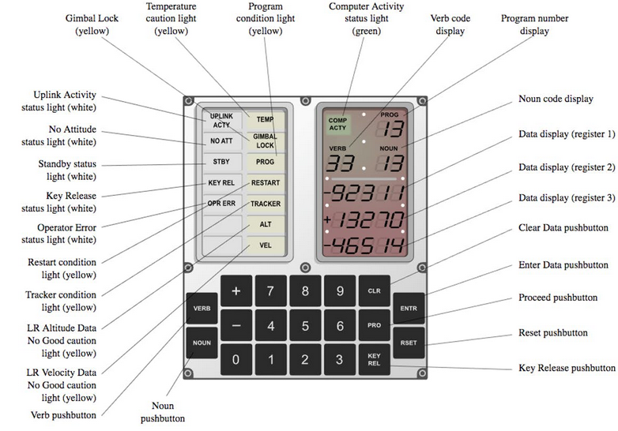

Slide 35
Nouns and verbs

Slide 36
# THE FOLLOWING QUOTATION IS PROVIDED THROUGH THE COURTESY OF THE AUTHORS.
#
# "IT WILL BE PROVED TO THY FACE THAT THOU HAST MEN ABOUT THEE THAT
# USUALLY TALK OF A NOUN AND A VERB, AND SUCH ABOMINABLE WORDS AS NO
# CHRISTIAN EAR CAN ENDURE TO HEAR.“
Henry VI, Part 2, Act 4

Slide 37
Verbs
50 PLEASE PERFORM
51 PLEASE MARK
53 PLEASE MARK ALT LOG
54 REND COAS MARK
56 TERMINATE P20
58 STICKFLAG (R) V50N18 FLAG(S)
64 OPTICS ANGLE TRANSFORM
76 ENABLE VHF DATA PROC

Slide 38
Nouns
04 ATT ERR
05 ANG SEP ERR-ANG SEP
06 OPTION CODE
09 ALARM CODES
11 TIG NCC
13 TIG NSR
14 STAR TRKR 06.16
18 AUTO MN VR

Slide 39
Combinations
Verb 37 Enter 63 Enter
V37 = Select Program
63 = sub program (P63)
Verb 5 Noun 9 Enter
Display program alarm codes (1202 / 1201)

Slide 40
Building the software

Slide 41
AGC utilities
It didn’t have any that ran on the device
No text editor
No assembler / compiler
No linker

Slide 42
Cross-compiler
A cross compiler is a compiler capable of creating executable code for a platform other than the one on which the compiler is running.
For example, a compiler that runs on a Windows 7 PC but generates code that runs on Android smartphone is a cross compiler.

Slide 43
Process
Assemble the program to machine code – oops – not enough mainframe memory!
Compile 20% of the program – write output to file on tape A
Compile next 20% of the program – write output to file on tape A
…
Read the five output files on tape A and concatenate to one file on tape B
Read the machine code from tape B, convert to binary and create the rope instructions

Slide 44
The types of code
Assembler - ADS LOCCTR
Machine code - 06 1200 Assume 06 is CPU code for ADS
Assume LOCCTR at address 1200
Binary - 110 0 0001 0010 0000

Slide 45
1202 Alarm
NEXTCORE CAF COREINC # “Clear and add fixed” – move *COREINC into # accumulator
ADS LOCCTR # “Add to storage” – add accumulator to *LOCCTR
CCS EXECTEM2 # “Count, Compare and Skip”
TCF NOVAC3 # EXECTEM2 > 0 – “Transfer control to fixed”
TC BAILOUT # = 0 - NO CORE SETS “Transfer control” – Call # BAILOUT
OCT 1202 # < 0 – Octal number?

Slide 46
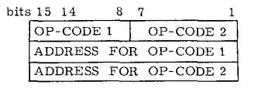
Interpreter
In particular, the interpretive language used 7-bit opcodes and 15-bit address fields, using the following packed instruction format:
In other words, they packed two instructions in three words.

Slide 47
Interpreter code
FLAGORGY TC INTPRET # DIONYSIAN FLAG WAVING CLEAR CLEAR NOTHROTL REDFLAG CLEAR SET LRBYPASS MUNFLAG CLEAR CLEAR P25FLAG # TERMINATE P25 IF IT IS RUNNING. RNDVZFLG # TERMINATE P20 IF IT IS RUNNING
(Dionysus is the god of the grape harvest, winemaking and wine, of ritual madness, fertility, theatre and religious ecstasy)

Slide 48
CLEAR NOTHROTL: “Permit full throttle”
CLEAR REDFLAG: “Landing site redesignation not permitted”
CLEAR LRBYPASS: “Do not bypass landing radar updates”
SET MUNFLAG: “Servicer calls MUNRVG” (MUNRVG is a subroutine that performs some computations needed by the thrusting program)
CLEAR P25FLAG: “P25 not operating” CLEAR RNDVZFLG: “P20 not running” P20 and P25 are programs used during the rendezvous between the command module and the lunar module.

Slide 49
How to be a developer – circa 1960!

Slide 52
Punched card

Slide 53
IBM card punch

Slide 54
IBM card reader

Slide 56
Punch card deck

Slide 58
The mission

Slide 59
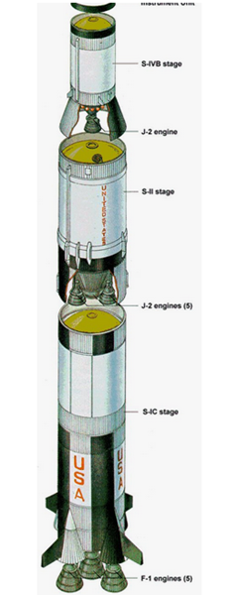

Slide 60
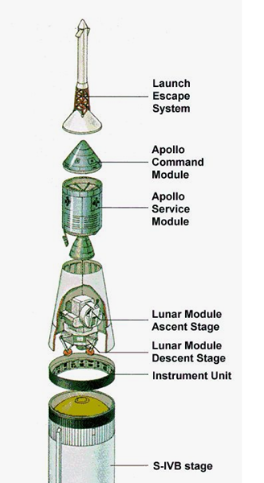

Slide 61
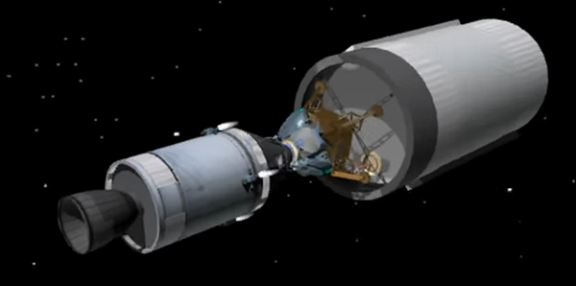

Slide 62
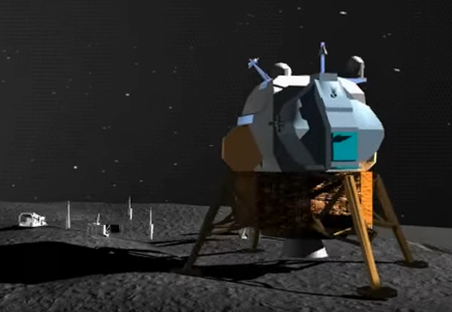

Slide 63
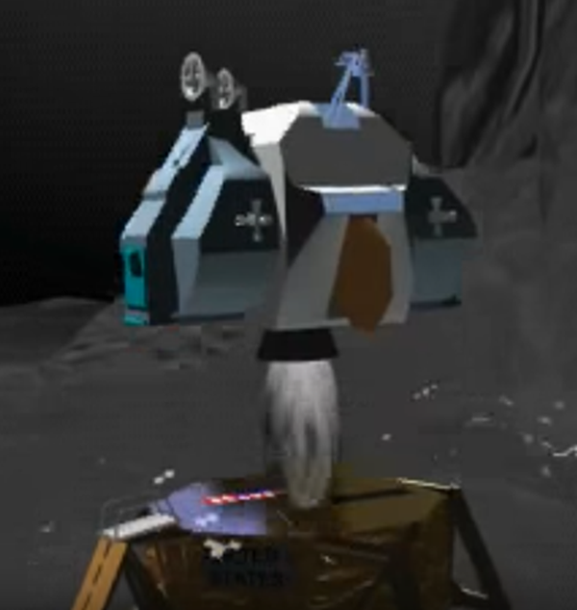

Slide 64
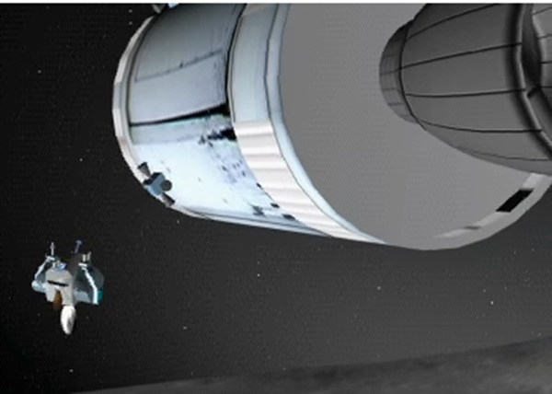

Slide 65
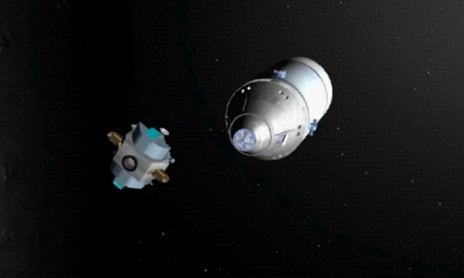

Slide 66
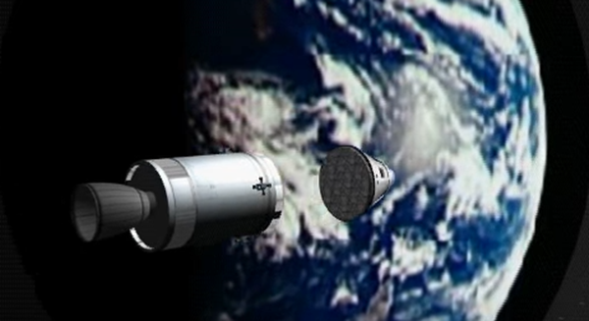

Slide 68
Mission Control

Slide 69
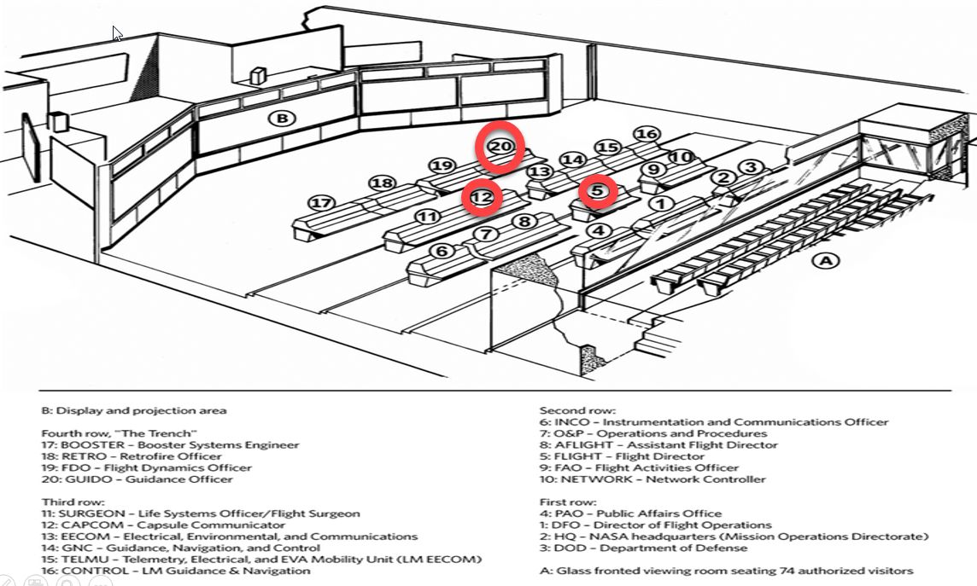

Slide 71
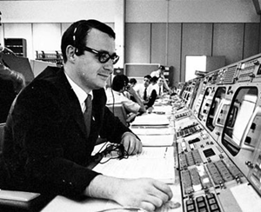
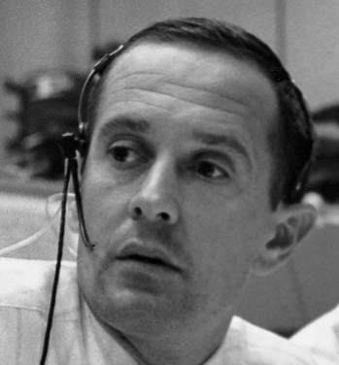
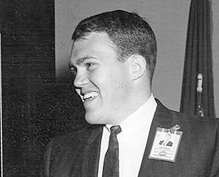
The players – Kranz, Bales, Garman, Duke

Slide 72
Apollo 11

Slide 73
1202 alarm

Slide 74
1201 alarm

Slide 75
The Eagle has landed

Slide 77
Apollo 14

Slide 78
The abort switch
Had roughly 90 minutes – fuel, oxygen, the sun.
Code, test, simulate, upload.
E.g. Verb 21 Noun 1 Enter 1010 Enter 107 Enter
Sets mode register to 71 = Abort in progress
Verb 21 Noun 1 = Load full word
1010 = Address of flags register
107 = Turn abort bit on
65 keystrokes

Slide 79
The “end”

Slide 80
The legacy
Only 75 Apollo Guidance computers were ever made, and on average, they each cost the United States around $200,000 (equivalent to $1.5 million today).
The AGC helped 12 men to land on the moon and return safely to earth
It played a major role in the safe recovery of Apollo 13
It never crashed!

Slide 81
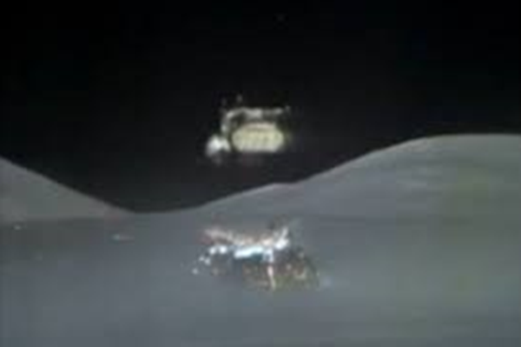
December 14th 1972 – Apollo 17 blasts off from the moon
The last lunar mission
Sadly, we have never been back

Slide 82
References
Sunburst and Luminary – An Apollo Memoir – Don Eyles
The Apollo Guidance Computer – Architecture and Operation – Frank O’Brien
Digital Apollo – Davis A Mindell
Left Brains for the Right Stuff – Hugh Blair-Smith
Virtual AGC – Home Page - http://www.ibiblio.org/apollo/
Original Apollo 11 Guidance Computer (AGC) source code for the command and lunar modules - https://github.com/chrislgarry/Apollo-11

