Slide 1
Lovelace and Babbage and the dawn of computing
Rory Braybrook
@rbrayb

Slide 2
Graphic novel
By Source (WP:NFCC#4), Fair use, https://en.wikipedia.org/w/index.php?curid=45704123

Slide 3
Charles Babbage

Slide 4
Life (1)
Born in 1791
Polymath
Educated at Cambridge
He lectured to the Royal Institution on astronomy in 1815, and was elected a Fellow of the Royal Society in 1816

Slide 5
Life (2)
Instrumental in founding the Royal Astronomical Society in 1820
On his father's death in 1827, Babbage inherited a large estate (value around £100,000, equivalent to £8.5 million)

Slide 6
Logarithms

Slide 7
Difference engine no. 1
Babbage's first attempt at a mechanical computing device, the Difference Engine, was a special-purpose machine designed to tabulate logarithms and trigonometric functions by evaluating finite differences to create approximating polynomials.
Construction of this machine was never completed; Babbage had conflicts with his chief engineer, Joseph Clement, and ultimately the British government withdrew its funding for the project
Difference Engine No. 1 called for 25,000 parts and would have weighed fifteen tons and would have been 8 ft tall
The cost was £17,500 - the cost of twenty-two brand new steam locomotives from Robert Stephenson's factory in 1831

Slide 8
Model of the difference engine
By User:geni - Photo by User:geni, CC BY-SA 4.0, https://commons.wikimedia.org/w/index.php?curid=4807331

Slide 9
Close up
By Carsten Ullrich - Own work, CC BY-SA 2.5, https://commons.wikimedia.org/w/index.php?curid=851017

Slide 10
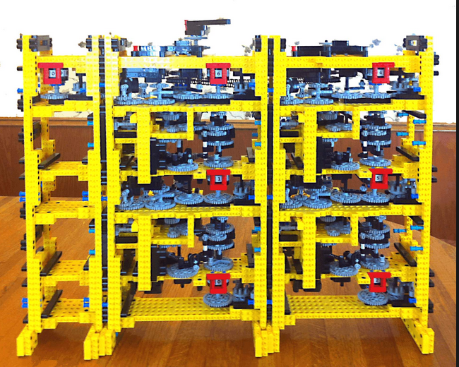
Difference engine - Lego

Slide 11
Carry

Slide 12
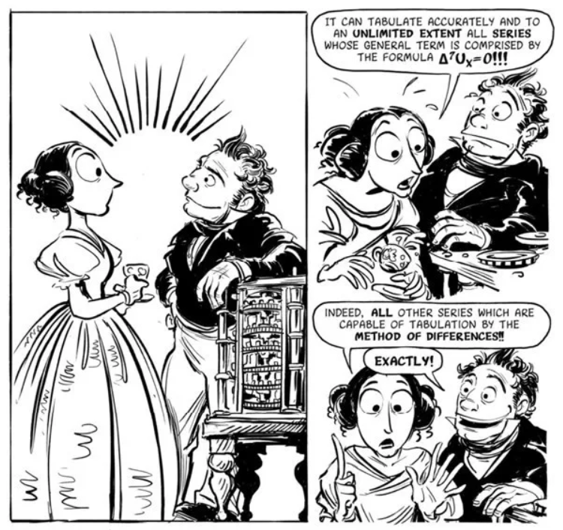
Small model

Slide 13
Polynomial functions and the method of differences
f(x,y) = 2x² + xy
Any second-degree polynomial can be computed this way and, more generally any n^{th} degree polynomial can be computed, using only addition, starting with the n^{th} difference.

Slide 14
Method of differences
f(x) = x² + 4
f(5) = 25 + 4 = 29
f(6) = 36 + 4 = 40

Slide 15
Education (1)
Men were expected to be in charge outside the home, in the world of work, and women expected to be in charge within the home, in the world of childcare and household management
Girls were taught by governesses, and their education was tailored towards their role as wives and mothers. e.g. how to make delicate conversation, sew, needlecraft or manage servants
They were expected to marry a “suitable” young man, have children and look forward to a life in the country with a break to attend the season in London

Slide 16
Education (2)
In 1869, the first female students in Britain to be admitted to university, at the University of London
In 1919, women were allowed to become lawyers, vets and civil servants
In 1920, Oxford let women take degrees.
The first women were elected as Fellows of the Royal Society in 1945

Slide 17
Ada Lovelace – the enchantress of numbers

Slide 18
Life
Born in 1815
Only legitimate child of Lord Byron who went overseas when Ada was five months old
Married the Count of Lovelace, becoming Augusta Ada King, Countess of Lovelace
First met Babbage in 1833 when she was 17

Slide 19
Lord Byron
British Romantic poets include Wordsworth, Coleridge, Keats, Shelley, Byron and Blake.

Slide 20
Ada - mathematics

Slide 21
Babbage - Jacquard loom
By Edal Anton Lefterov - Own work, CC BY-SA 3.0, https://commons.wikimedia.org/w/index.php?curid=11959365

Slide 22
Analytical engine
Babbage started work on a much more general design, the Analytical Engine, in 1833
The input, consisting of programs and data ("formulae" and "data") was to be provided to the machine via punched cards
For output, the machine would have a printer, a curve plotter and a bell

Slide 23
Analytical engine
There was to be a store (that is, a memory) capable of holding 1,000 numbers of 40 decimal digits each
An arithmetic unit (the "mill") would be able to perform all four arithmetic operations, plus comparisons and optionally square roots.
Like the central processing unit (CPU) in a modern computer, the mill would rely upon its own internal procedures, to be stored in the form of pegs inserted into rotating drums called "barrels", to carry out some of the more complex instructions the user's program might specify.

Slide 24
Analytical engine
The programming language to be employed by users was akin to modern day assembly languages
Loops and conditional branching were possible, and so the language as conceived would have been Turing-complete as later defined by Alan Turing
Three different types of punch cards were used: one for arithmetical operations, one for numerical constants, and one for load and store operations, transferring numbers from the store to the arithmetical unit or back
There were three separate readers for the three types of cards

Slide 25
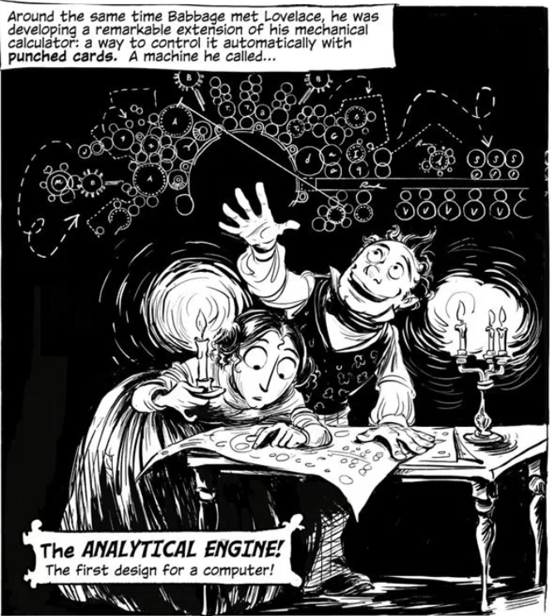
Analytical Engine

Slide 26
Aside : Turing complete
A programming language is said to be Turing Complete if it can simulate a single taped Turing machine. In general for a programming language to be Turing-complete it needs:
1. A form of conditional repetition or conditional jump (while, for, if and goto)
2. A way to read and write to some storage mechanism (variables)

Slide 27
Diagram of the analytical engine
By ArnoldReinhold - Own work, CC BY 4.0, https://commons.wikimedia.org/w/index.php?curid=69497631

Slide 28
Part of the analytical engine
By Bruno Barral (ByB), CC BY-SA 2.5, https://commons.wikimedia.org/w/index.php?curid=6839854

Slide 29
Punched cards
Foreground: 'operational cards', for inputting instructions; background: 'variable cards', for inputting data
By Karoly Lorentey - originally posted to Flickr as Punched cards for programming the Analytical Engine, 1834-71, CC BY 2.0, https://commons.wikimedia.org/w/index.php?curid=11833648

Slide 30
Full model
The store (memory) 2. The Mill (CPU) 3. Steam engine 4. Printer
5. Operation cards (program) 6. Variable cards (addressing)
7. Number cards 8. Barrel controller (microprograms)

Slide 31
The mill columns

Slide 32
Types of cards
Operation - used to set up the mill to perform the specified arithmetic operation (+, -, x, %)
Number - used to put numerical values in the store at the specified wheel number
Variable - used to transfer values from the Store to the Mill, or from the Mill to the store. The machine can either erase the number as it transfers it, or leave it intact to use again
Combinatorial - used to perform loops and jumps in the program
Special - used to halt the engine, ring a bell, or give comments to the engine operator

Slide 33
4! – step 1
Instruction |  | M 0 | M 1 | M 2 |  | Ingress 1 | Ingress 2 |  | Egress
N000 4 |  | 4
N001 1 |  |  | 1
N002 1 |  |  |  | 1
x
L001 |  |  |  |  |  | 1
L000 |  |  |  |  |  |  | 4 |  | 1 x 4 = 4
S001 |  |  | 4
-
L000 |  |  |  |  |  | 4
L002 |  |  |  |  |  |  | 1 |  | 4 -1 = 3
S000 |  | 3
L002 |  |  |  |  |  | 1
L000 |  |  |  |  |  |  | 3 |  | 1 - 3 = -2
CB?11

Slide 34
4! – step 2
Instruction |  | M 0 | M 1 | M 2 |  | Ingress 1 | Ingress 2 |  | Egress
 |  | 3 | 4 | 1
x
L001 |  |  |  |  |  | 4
L000 |  |  |  |  |  |  | 3 |  | 4 x 3 = 12
S001 |  |  | 12
-
L000 |  |  |  |  |  | 3
L002 |  |  |  |  |  |  | 1 |  | 3 - 1 = 2
S000 |  | 2
L002 |  |  |  |  |  | 1
L000 |  |  |  |  |  |  | 2 |  | 1 - 2 = -1
CB?11
Etc.
B
H

Slide 35
Speed
Luigi Federico Menabrea reported in Sketch of the Analytical Engine: "Mr. Babbage believes he can, by his engine, form the product of two numbers, each containing twenty figures, in three minutes"
By comparison the Harvard Mark I could perform the same task in just six seconds
A modern PC can do the same thing in well under a billionth of a second

Slide 36
Menabrea

Slide 37
Ada – Note B

Slide 38
Bernoulli numbers

Slide 39
Bernoulli numbers
“The Bernoulli numbers are particularly amenable to machine calculation because they are defined recursively: we may use the first to determine the second, the second for the third, and so on.”
There are several different ways of calculating these numbers, and Lovelace did not choose the simplest
She noted instead that the “object is not simplicity or facility of computation, but the illustration of the powers of the engine”

Slide 40
Ada = Note G

Slide 41
Bernoulli (1)

Slide 42
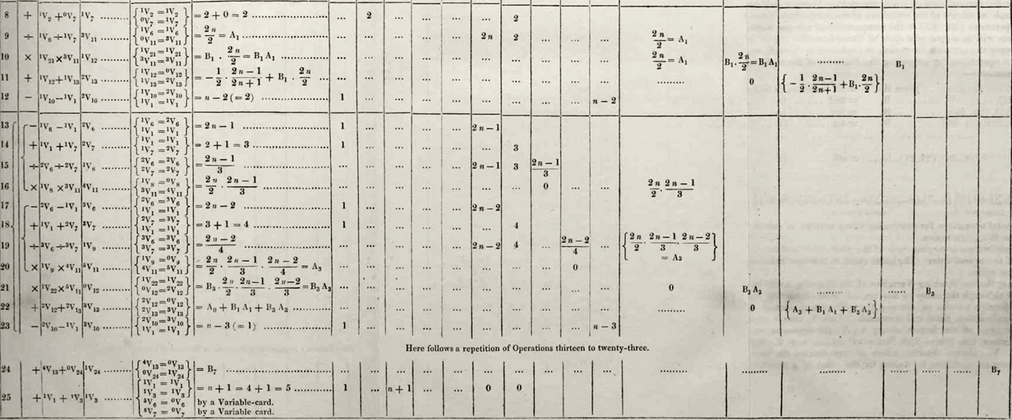
Bernoulli (2)

Slide 43
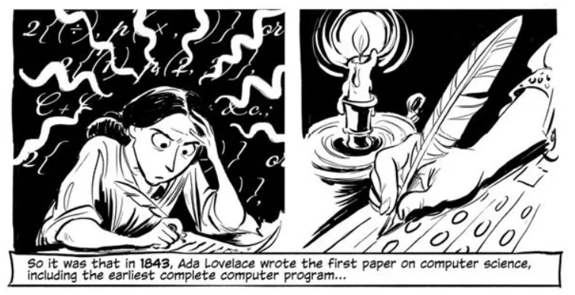
First paper

Slide 44
Limitations
“The Analytical Engine has no pretensions whatever to originate anything.
It can do whatever we know how to order it to perform.
It can follow analysis; but it has no power of anticipating any analytical relations or truths.
Its province is to assist us in making available what we are already acquainted with.”

Slide 45
Imagination and vision
Ada observed a fundamental principle of the machine, that the operations, defined by the cards, are separate from the data and the results.
She observed that the machine might act upon things other than number, if those things satisfied mathematical rules.
“Supposing that the fundamental relations of pitched sounds in the science of harmony and of musical composition were susceptible of such expression and adaptations, the engine might compose elaborate and scientific pieces of music of any degree of complexity or extent”

Slide 46
Imagination and vision
She thought about how the engine might do algebra, how it “weaves algebraical patterns just as the Jacquard loom weaves flowers and leaves”
And how it might make new discoveries; “We might even invent laws for series or formulæ in an arbitrary manner, and set the engine to work upon them, and thus deduce numerical results which we might not otherwise have thought of obtaining”

Slide 47
Difference Engine No. 2
Babbage's Difference Engine No. 2 has 'registers' to hold one number from each of the columns in the table (for example 20, 7, 2)
It would add the second difference to the first, then add that result to the function value to compute the next entry in the table
There were enough 'registers' for seven differences, allowing it to compute 31-digit values for polynomials with terms up to x⁷

Slide 48
Comparison

Slide 49
And then (1) …
Babbage dabbled in cryptography. During the Crimean War of the 1850s, Babbage broke Vigenère's autokey cipher as well as the much weaker cipher that is called Vigenère cipher today. His discovery was kept a military secret, and was not published
He died in 1871. He declined both a knighthood and baronetcy
Babbage was clearly a man ahead of his time
He is known to have said he would give up the rest of his life to spend just three days 500 years in the future

Slide 50
And then (2) …
Ada tried to find a mathematical system for predicting the results of horse racing. She lost thousands of pounds!
She died in 1852 at the age of 36

Slide 51
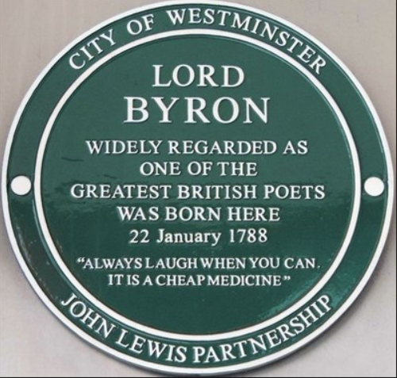
Lord Byron

Slide 52
Charles Babbage
By Simon Harriyott from Uckfield, England - Charles BabbageUploaded by Oxyman, CC BY 2.0, https://commons.wikimedia.org/w/index.php?curid=24731976

Slide 53
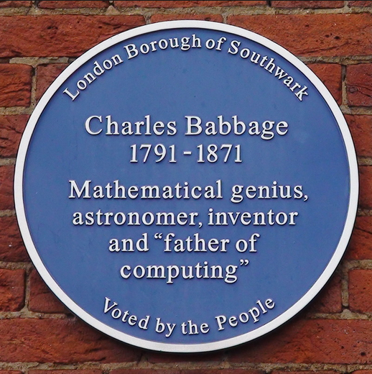
Charles Babbage

Slide 54
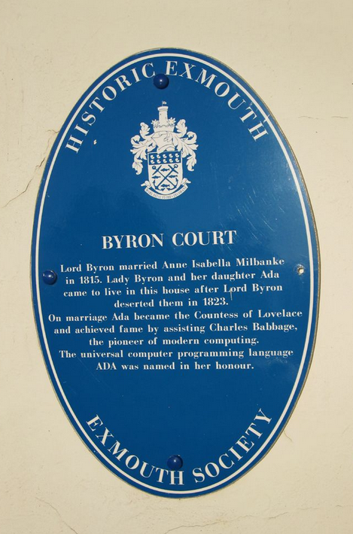
Byron Court

Slide 55
Ada Lovelace
By Egghead06 - Own work, CC BY-SA 3.0, https://commons.wikimedia.org/w/index.php?curid=22526431

Slide 56
Ada Lovelace Day
Ada Lovelace Day is an annual event celebrated on the second Tuesday of October, which began in 2009. Its goal is to "... raise the profile of women in science, technology, engineering, and maths," and to "create new role models for girls and women" in these fields

Slide 57
Google Doodle

Slide 58
Books

Slide 59
References
https://blog.stephenwolfram.com/2015/12/untangling-the-tale-of-ada-lovelace/
https://medium.com/@starkcoffee/discovering-adas-bernoulli-numbers-part-1-65bdfeb7cc8f
https://www.amazon.com/Thrilling-Adventures-Lovelace-Babbage-Computer/dp/0307908275
https://www.brainpickings.org/2015/06/15/the-thrilling-adventures-of-lovelace-and-babbage-sydney-padua/
https://www.youtube.com/watch?v=XSkGY6LchJs
https://www.fourmilab.ch/babbage/sketch.html
https://cs.stanford.edu/people/eroberts/courses/soco/projects/babbage/FormattedWell.html

Slide 60
References
Wikipedia
Ada Lovelace – The making of a computer scientist – Christopher Hollins
A female genius – James Essinger
Broadband – The women who made the Internet – Claire Evans
In Byron’s Wake – Miranda Seymour

Slide 61
Video
https://www.youtube.com/watch?v=XSkGY6LchJs

