Slide 1
Programming in the "dark" ages
Rory Braybrook
@rbrayb

Slide 2
Two phases:
Mainframe
Original IBM PC

Slide 3
The mainframe – circa 1970!

Slide 4
NASA mainframe - 1960

Slide 5
IBM card punch

Slide 6
IBM card reader

Slide 7
Tape drive

Slide 8
Tape drive
Q 1:
How much memory on a tape?
A:
At 200 characters per inch, a single 2400 foot tape (730 M) could store the equivalent of some 50,000 punched cards (about 4,000,000 six-bit bytes, or 3 MB).

Slide 9
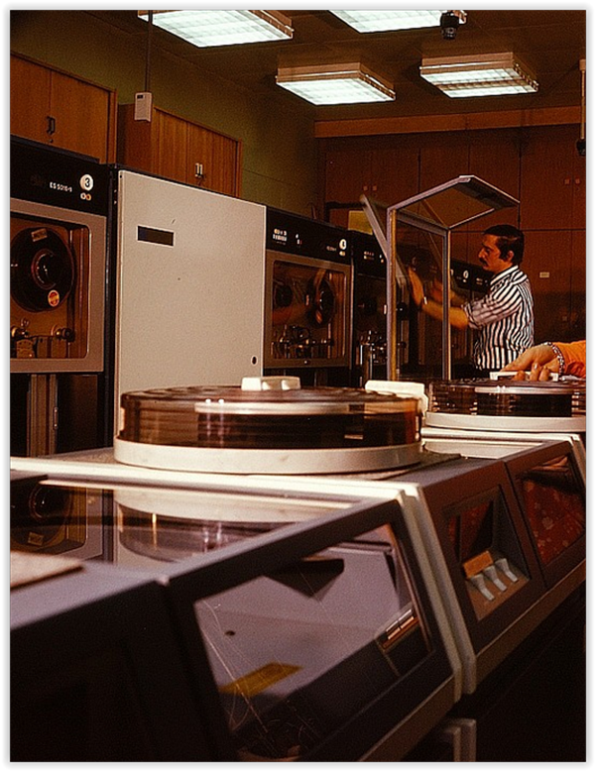
Disk drive

Slide 10
Disc drive
Q 2:
How much memory on a disc drive?
A:
The first disk drive to use removable media was the IBM 1311 drive – 2 MB
It was followed by the IBM 2311 (1964) - 5 MB
The IBM 3330 - 100 MB
The 3330-11 - 200 MB

Slide 11
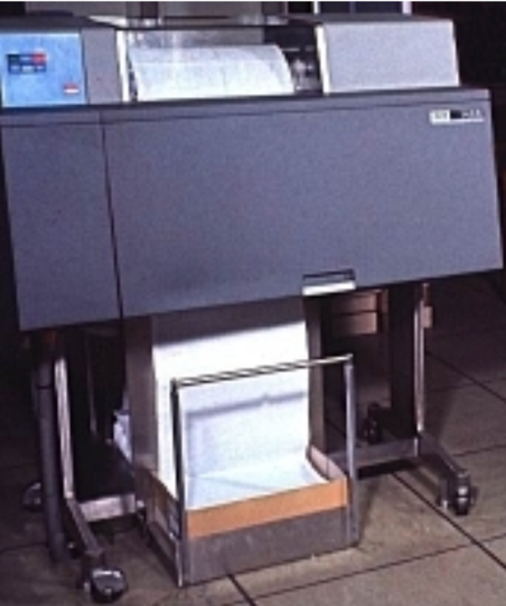
Printer

Slide 12
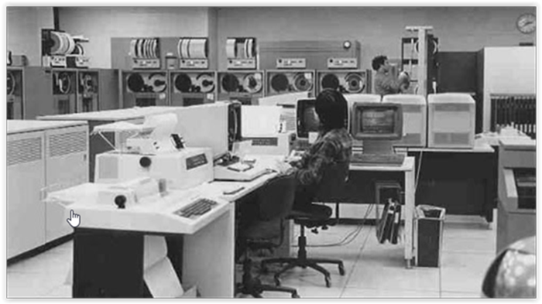
Control station

Slide 13
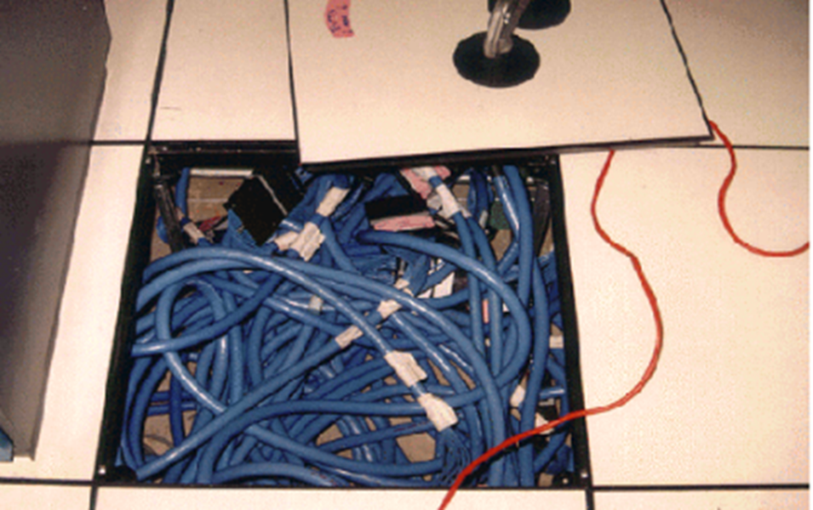
Raised floor

Slide 14
How to be a developer – circa 1970!

Slide 15
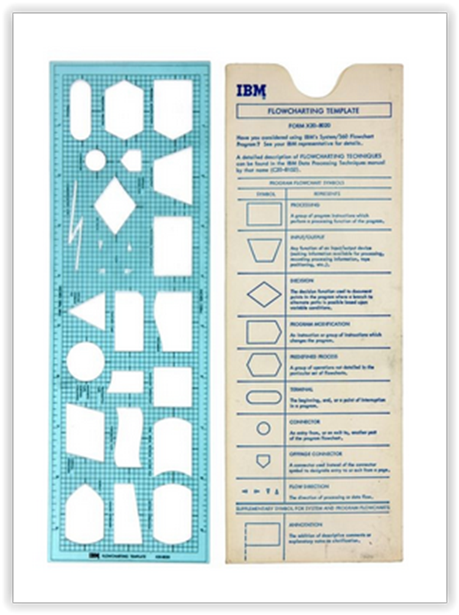
Flowcharting tool

Slide 16
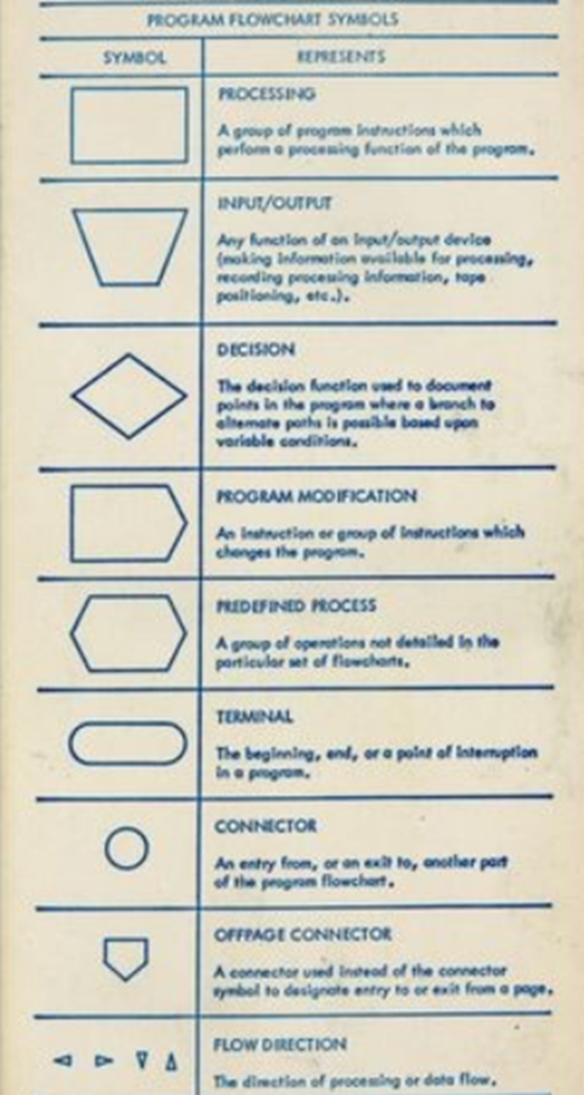
Flowcharting tool

Slide 17
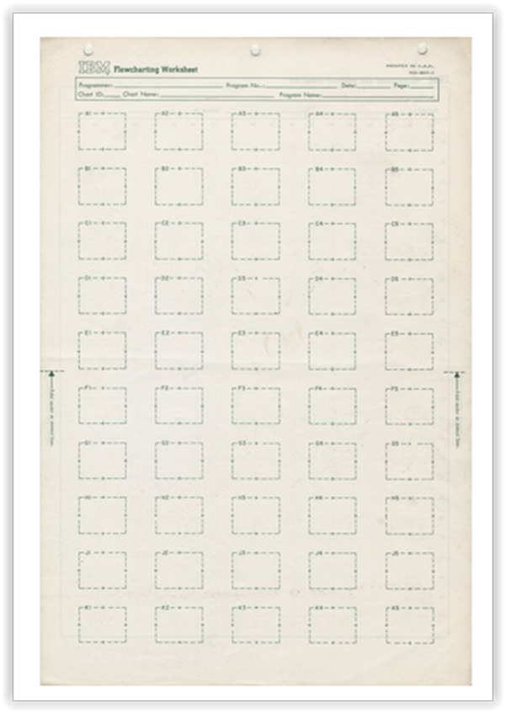
Flowcharting work sheet

Slide 18
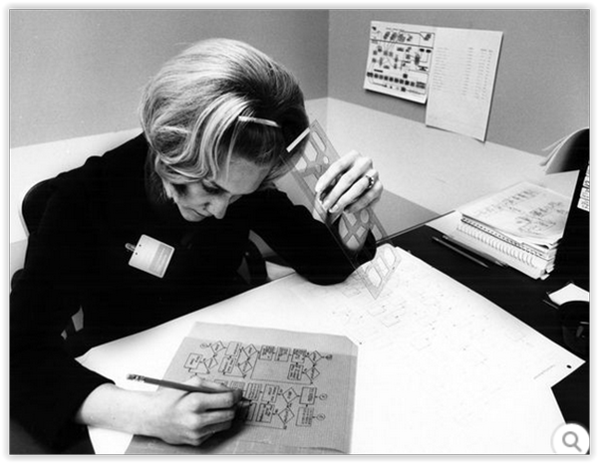
Flowcharting

Slide 19
Punch card sheet

Slide 20
COBOL programming sheet

Slide 21
Punched card

Slide 22
Punch card deck

Slide 23
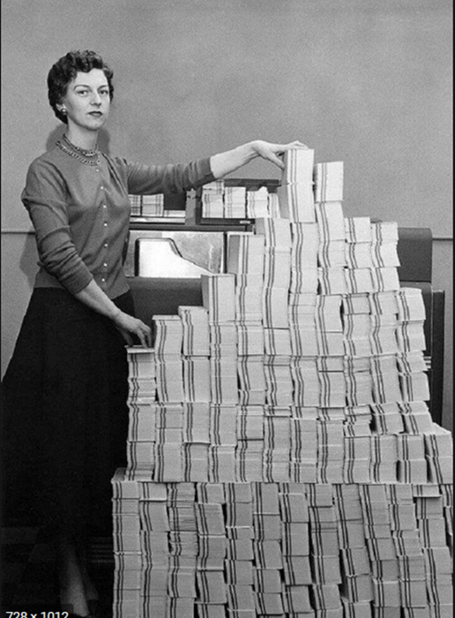
4.5 megabytes of data in 62,500 punched cards!

Slide 24
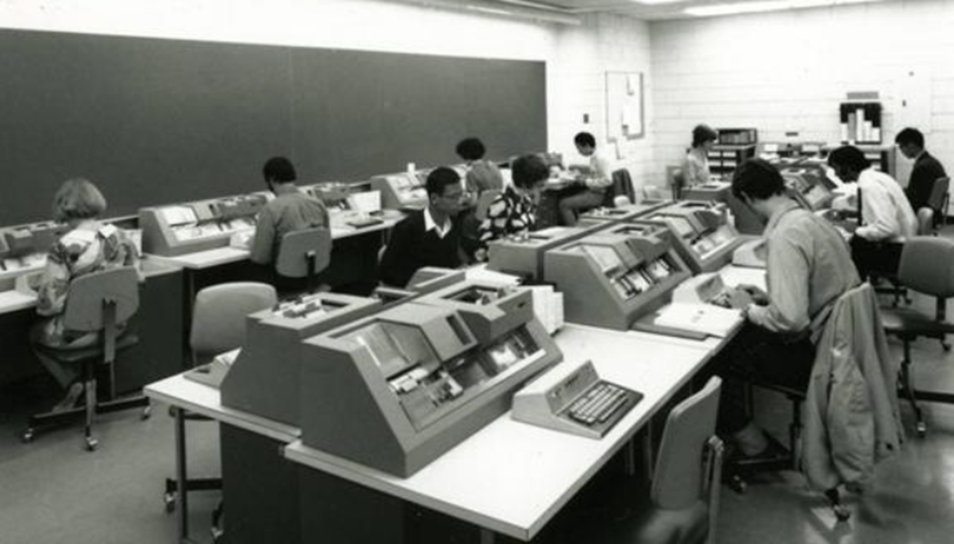
Hard at work

Slide 25
Punching the cards

Slide 26
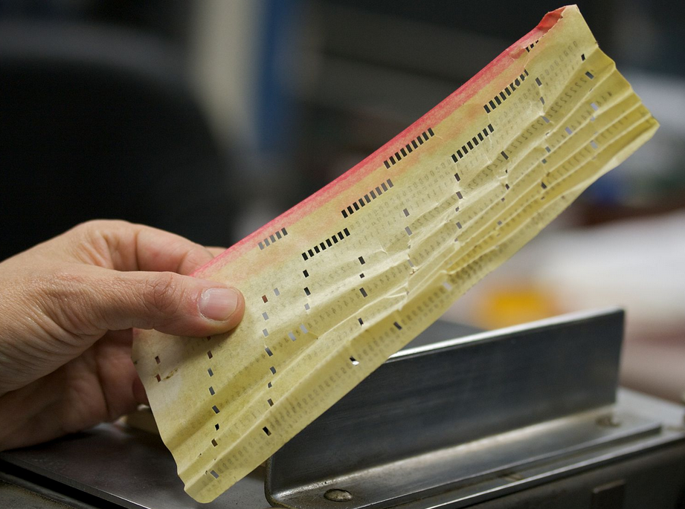
One mangled card!

Slide 27
The source code

Slide 28
Printouts

Slide 29
Workflow
Flowchart approved
Punch cards and JCL
Submit JCL and deck for compilation
Twiddle thumbs
Get deck back
Compilations errors ☹
Type new cards
Rinse and repeat
Similar process for execution

Slide 30
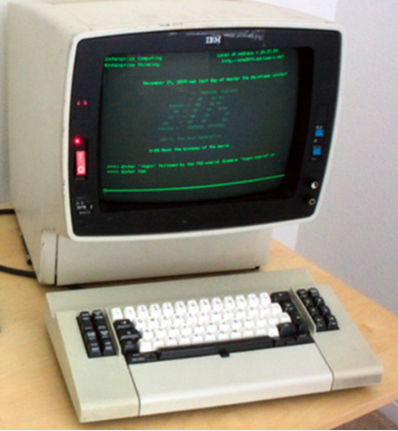
And then … IBM 3270 display terminal (green screen) VT100 80 x 24 characters

Slide 31
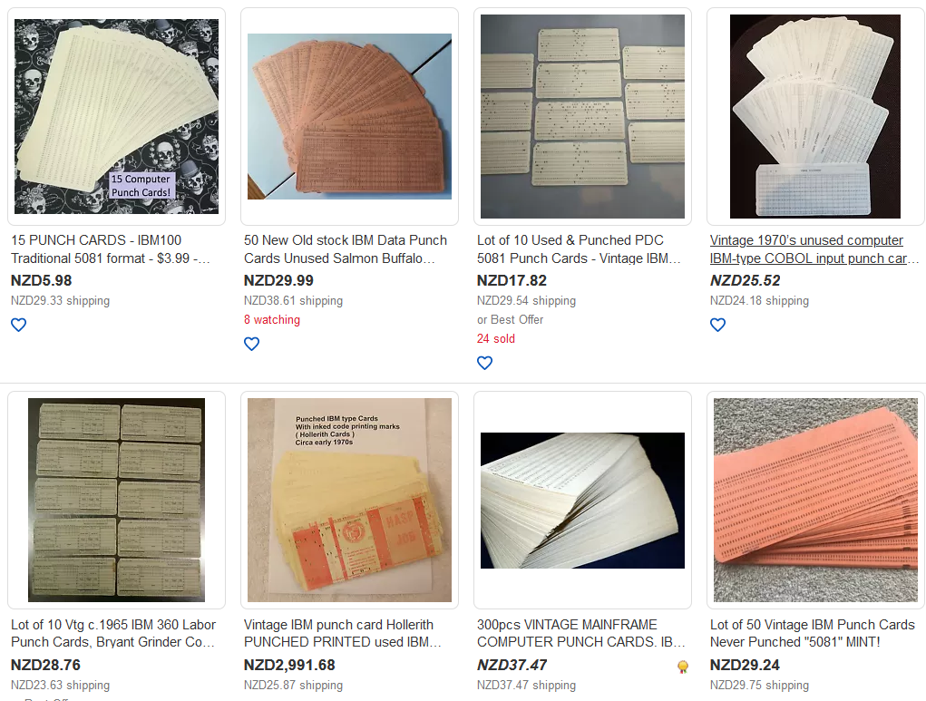
Punch cards aren’t dead – they just end up on eBay!

Slide 32
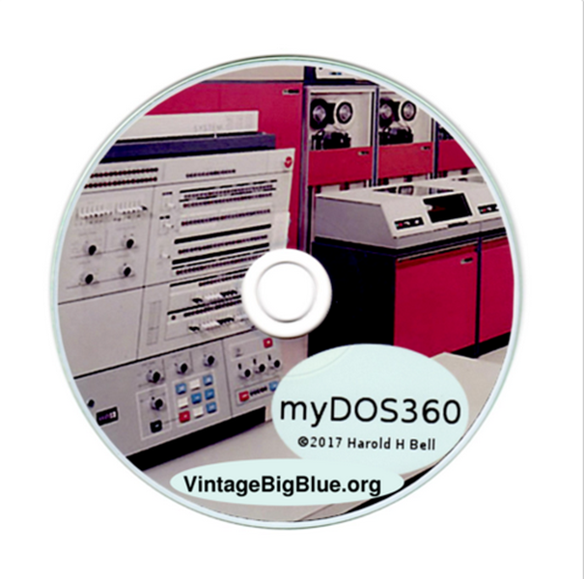
myDOS360 provides the GUI to run the first operating system that was available for the revolutionary IBM System 360 computer. It has COBOL, FORTRAN, RPG, and PL/1 compilers.

Slide 33
Programming Languages

Slide 34
Timeline

Slide 35
From this:

Slide 36
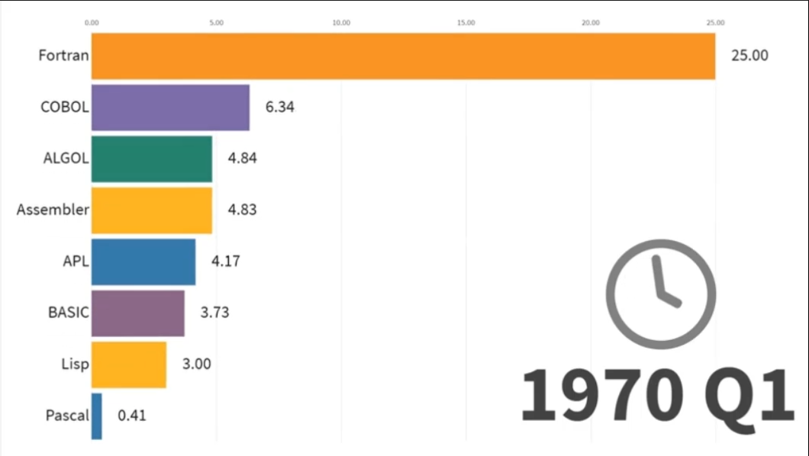
Via this:

Slide 37
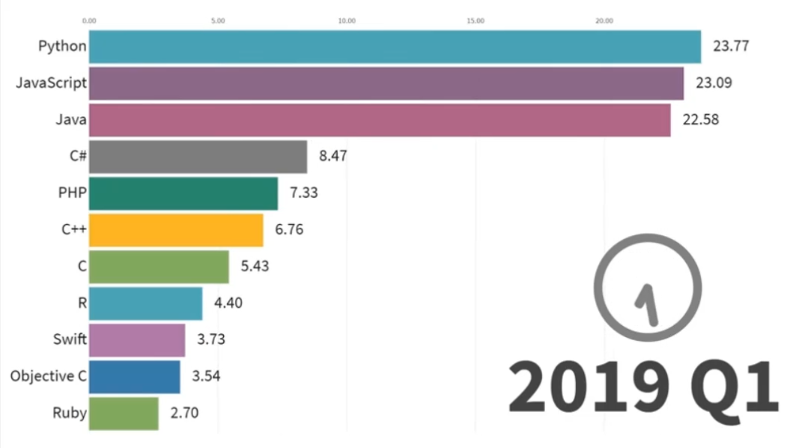
To this:

Slide 38
The PC – circa 1980

Slide 39
Apple 1 - 1976

Slide 40
IBM PC - 1981

Slide 41
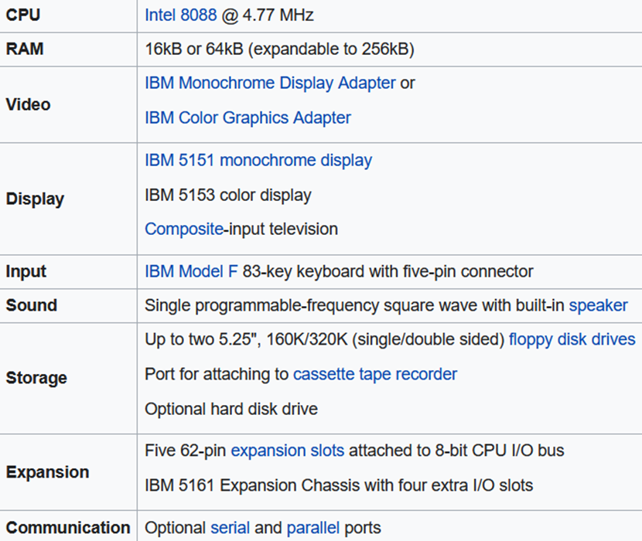
IBM PC

Slide 42
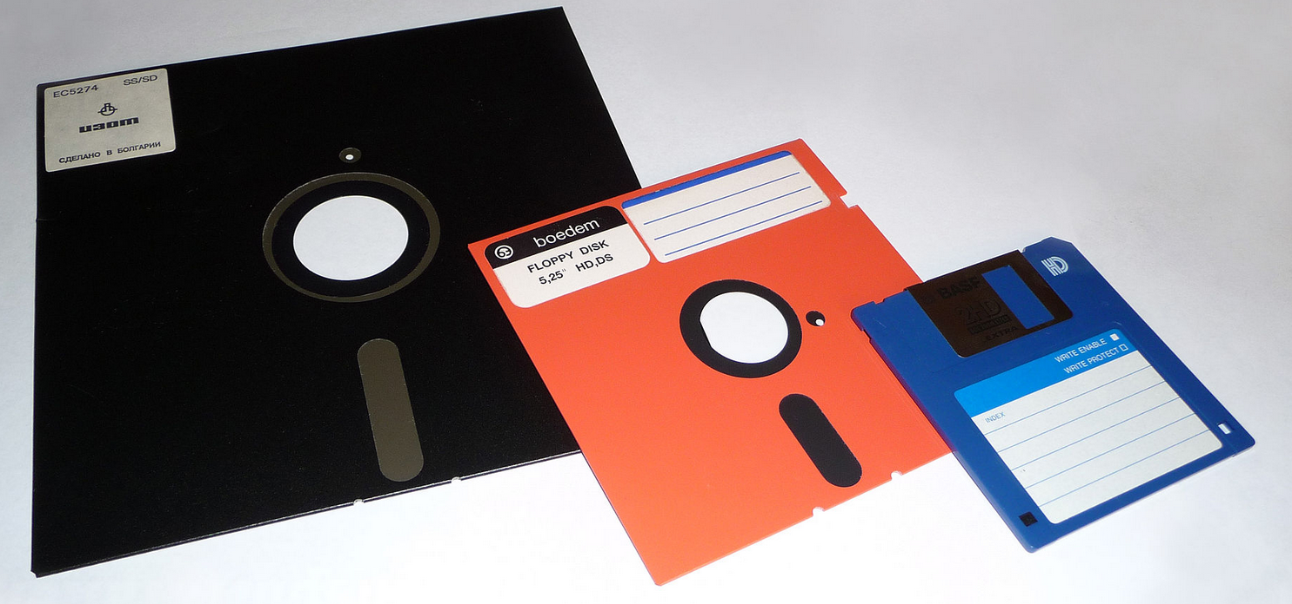
Floppy drives – 8”, 5 ¼”, 3 ½”

Slide 43
Floppy drive
8” - 240K bytes
Q 3:
How much memory on a 5 ¼ floppy?
A:
160 K / 320 K bytes (single / double sided)

Slide 44
Hard drive
Q 4:
How much memory on a hard drive (fixed disc) for the first IBM PC?
A:
Sorry! Trick question. There wasn’t one because they didn’t believe anyone would need that much storage.
When they did appear, they were 10 MB

Slide 45
Memory
Expanded memory is addressed from within the lower 1MB space, usually above 640K.
Extended memory has addresses greater than 1MB

Slide 46
Terminate and stay resident
A terminate-and-stay-resident program (commonly TSR) is a computer program running under DOS that uses a system call to return control to DOS as though it has finished, but remains in computer memory so it can be reactivated later. This technique partially overcame DOS's limitation of executing only one program, or task, at a time. TSRs are used only in DOS, not in Windows.
Some TSRs are utility software that a computer user might call up several times a day, while working in another program, using a hotkey.

Slide 47
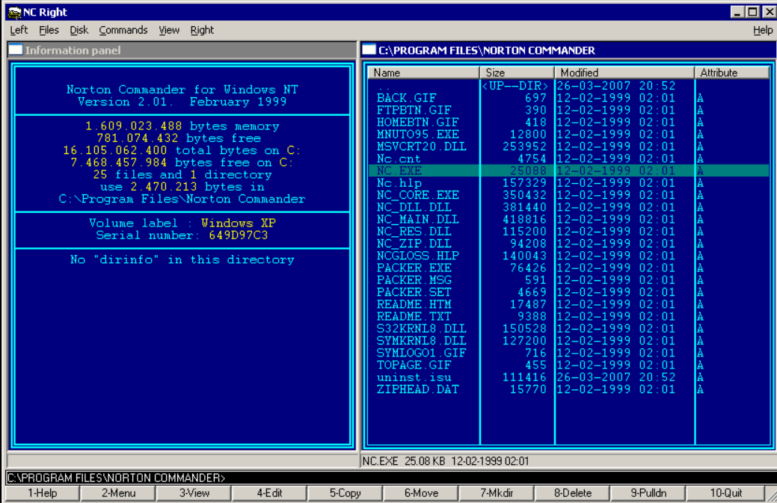
Norton Commander

Slide 48
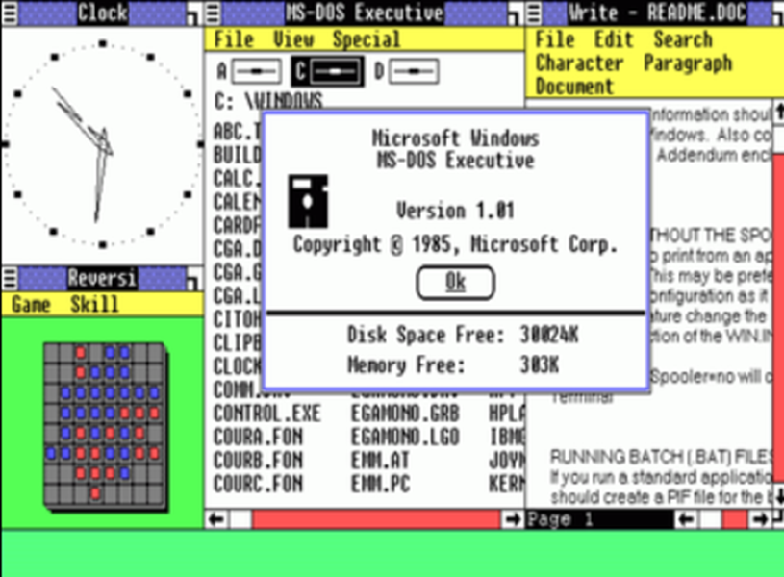
Windows 1.0
Requires two floppy
disk drives
and 192 KB of RAM

Slide 49
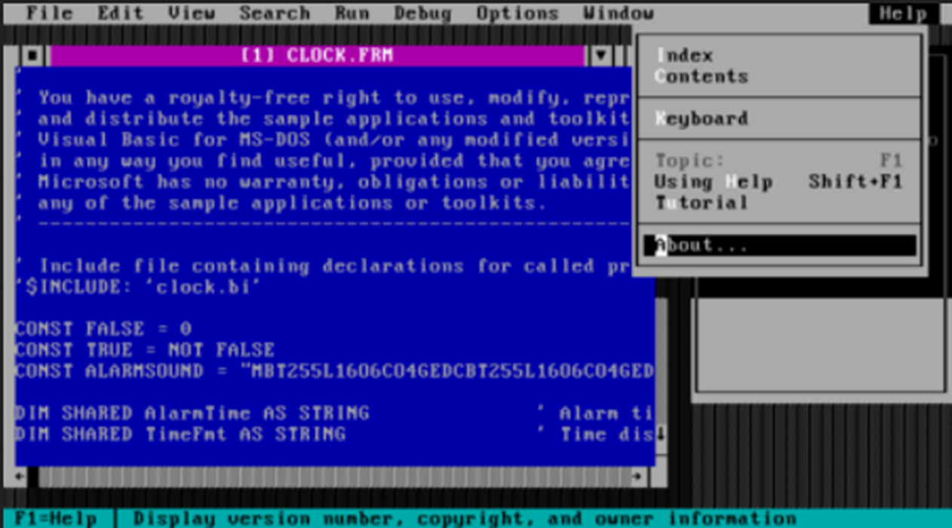
Visual Basic (1991)

Slide 50
The “Internet”

Slide 51
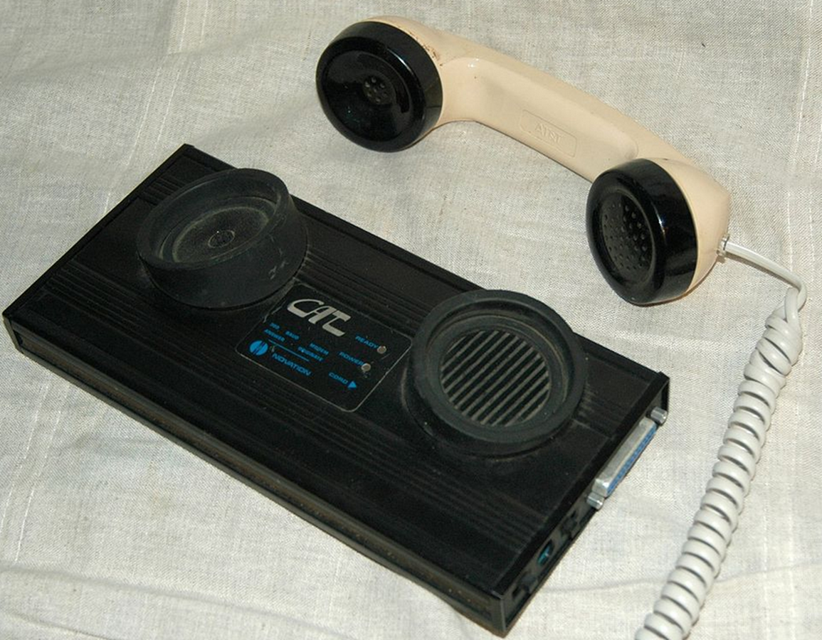
Acoustic Coupler (1200 baud = 150 bytes / sec = 540 K per hour)

Slide 52
Games

Slide 53
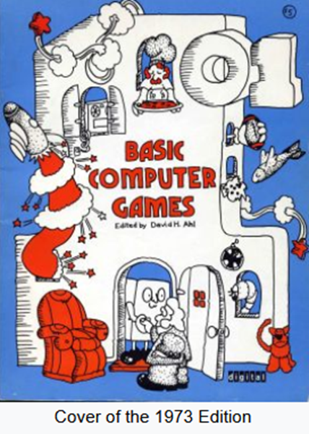
Davis Ahl – Basic Computing Games

Slide 54
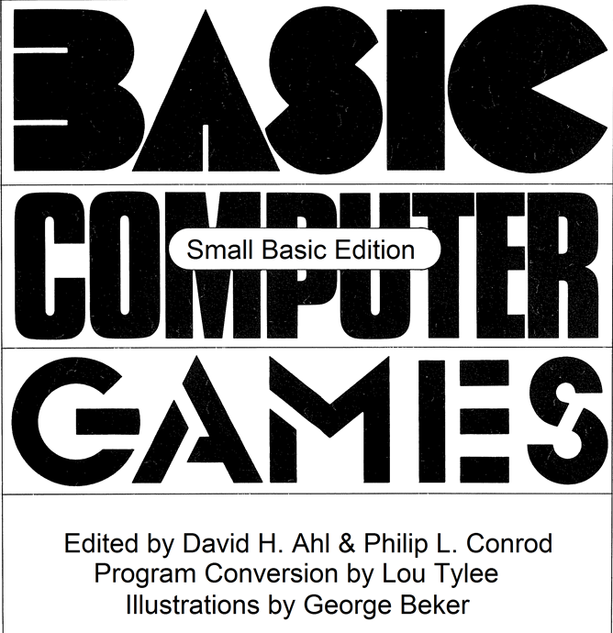
Basic Computing Games – Small Basic

Slide 55
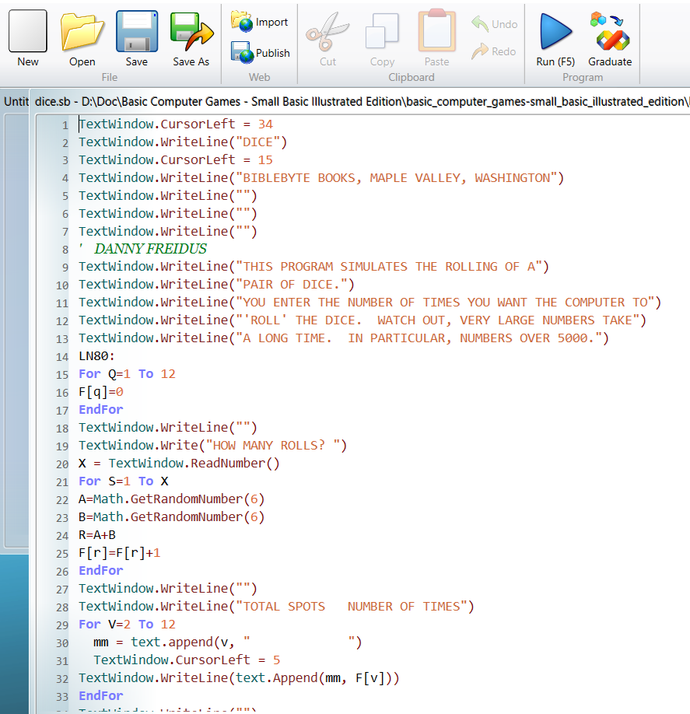
Basic Computing Games – Small Basic

Slide 56
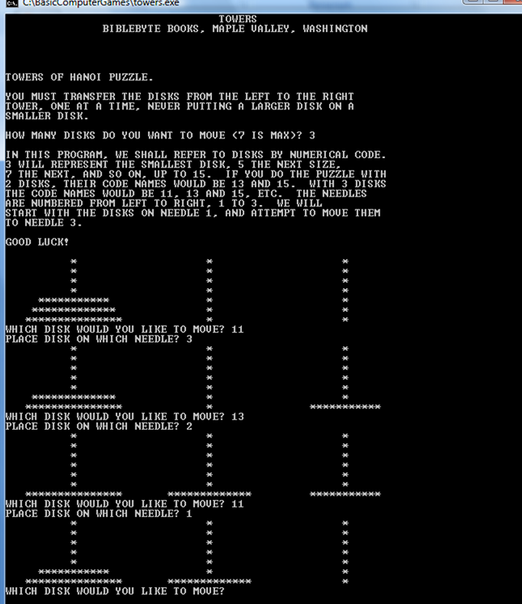
Basic Computing Games – Towers of Hanoi

Slide 57
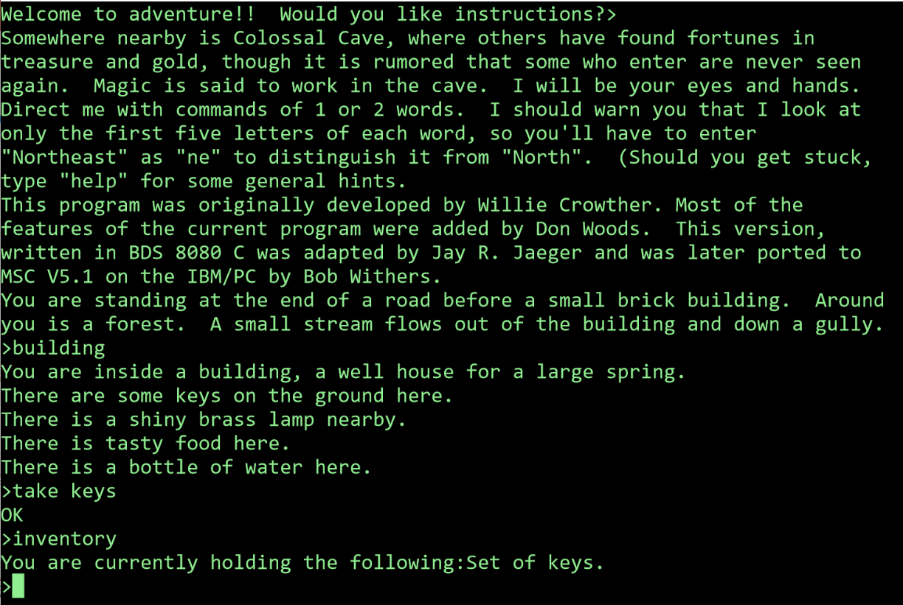
Colossal Cave Adventure

Slide 58
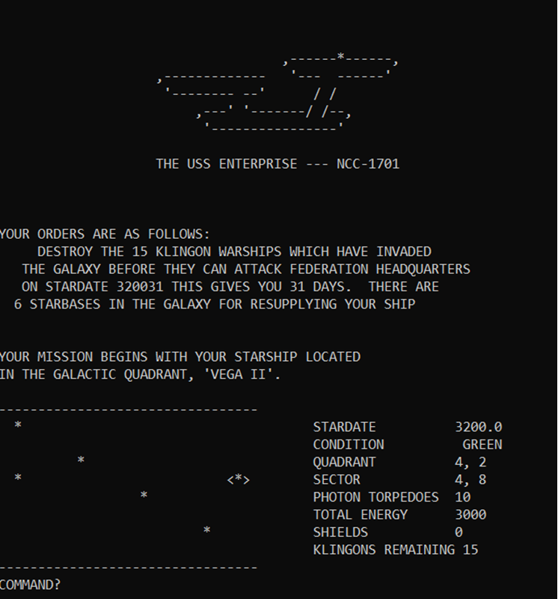
Star Trek

Slide 59
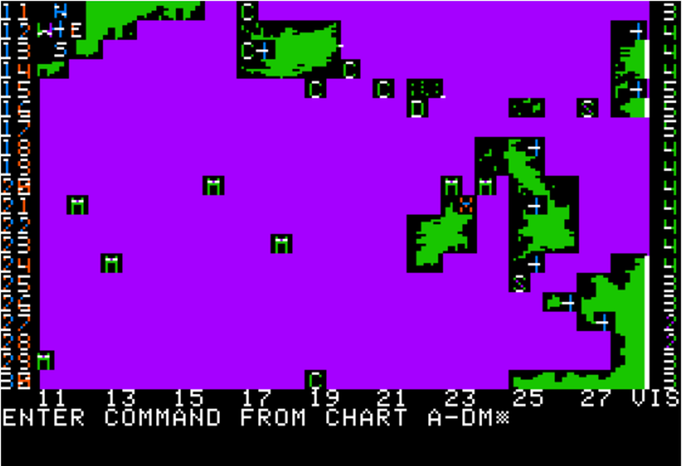
Computer Bismarck

Slide 60
Is COBOL dead?

Slide 61
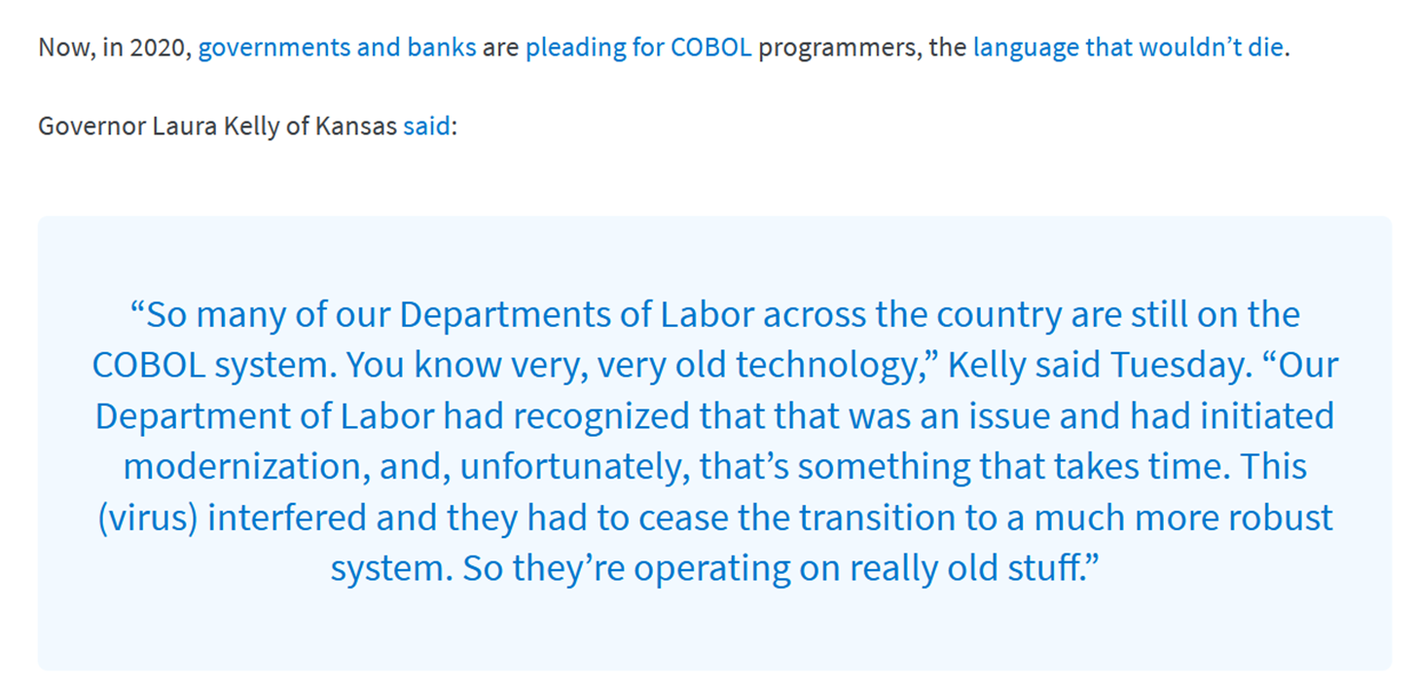

Slide 62
Bonus!

Slide 63
Microsoft Flight Simulator

Slide 65
References
The Computer History Museum - https://www.computerhistory.org
Tape drive - https://www.youtube.com/watch?v=7Lh4CMz_Z6M
Programming languages 1965 – 2019 - https://www.youtube.com/watch?v=Og847HVwRSI
Microsoft Flight Simulator - https://www.youtube.com/watch?v=gPuEb7BclsQ
Basic Computer Games – Small Basic -https://www.kidwaresoftware.com/SmallBasicComputerGames/
Colossal Cave Adventure - https://www.microsoft.com/en-nz/p/colossal-cave-adventure/9wzdncrdlv4h?activetab=pivot:overviewtab

Slide 66
References
Punching the cards - https://www.youtube.com/watch?v=YnnGbcM-H8c
IBM PC - https://en.wikipedia.org/wiki/IBM_Personal_Computer
Presentation - https://rbrayb.github.io/Presentations/

